Slide 1
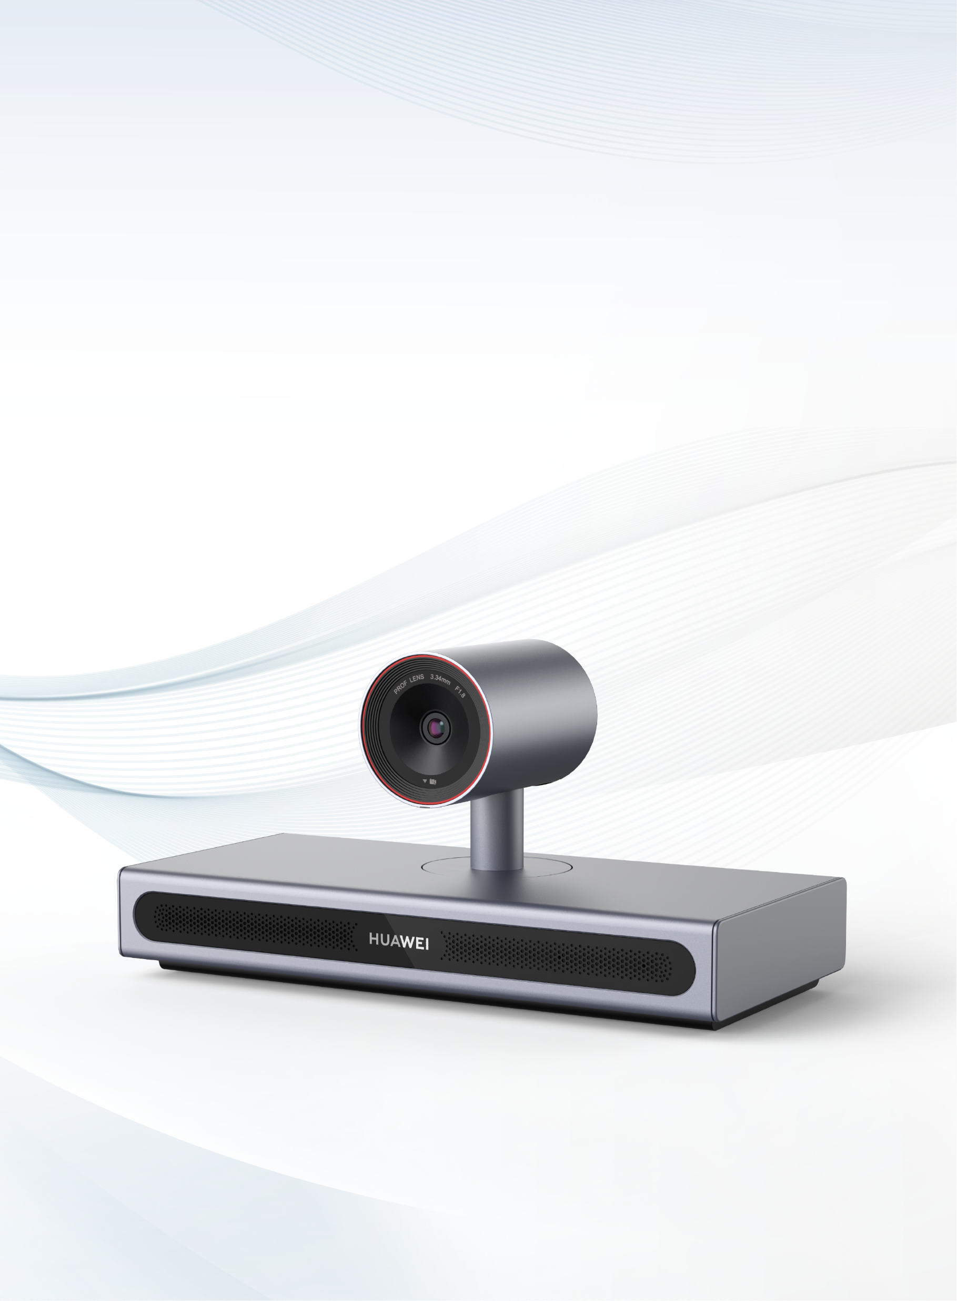

HUAWEI CloudLink Bar 210
Integrated Ultra-HD Video Conferencing Endpoint

Slide 2

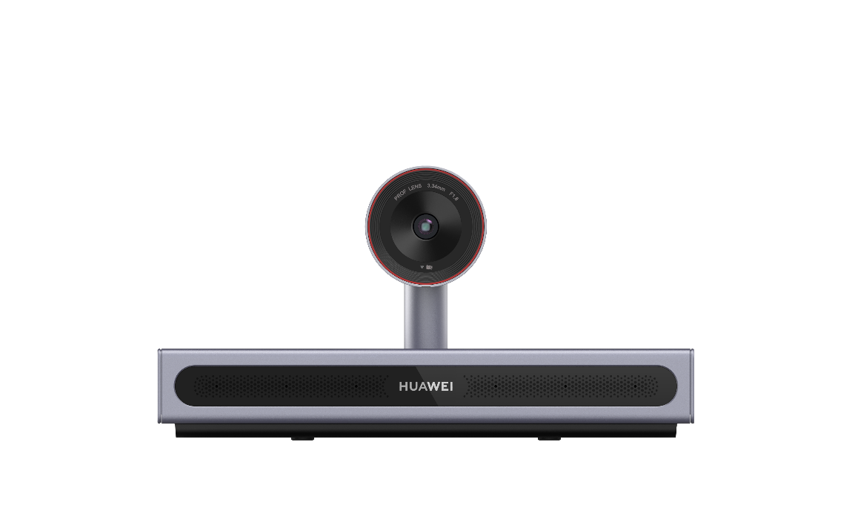


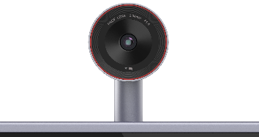
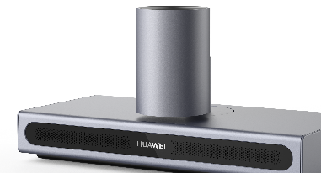
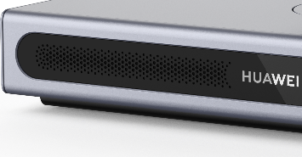


HUAWEI CloudLink Bar 210
Integrated Ultra-HD Video Conferencing Endpoint
Bar 210 is a next-generation ultra-HD video conferencing endpoint powered by Huawei's proprietary technologies and high-computing hardware platform architecture. It integrates a 4K camera, microphone array, and HD codec, and features a manual mechanical pan-tilt-zoom (PTZ) system with 3x digital zoom for clear, multi-angle viewing. With Auto-Framing, 1080p HD video quality, and a user-friendly design, Bar 210 is ideal for fast deployment in small to medium-sized conference rooms.
Privacy by design
1080p video
Integrated design
Camera rotation design for physical privacy protection
H.265 codec, audio and video multistreaming
Microphone + camera + codec
Highlights
Integrated Design
Integrated and minimalist design, with a built-in camera, microphone, and high-definition codec, for effortless cabling and easy installation.
The camera supports 90° downward rotation for 360° physical privacy protection, giving users full control over their privacy.
Equipped with a built-in microphone array with 8-meter pickup range, AI noise reduction, and natural voice reproduction, delivering a premium conference experience.
4K main camera
Privacy by design
Microphone array
Paint baking + oxidation
High Security and Reliability
Powerful performance, proprietary core technologies, and a high-computing hardware platform.
End-to-end encryption and media, as well as signaling encryption measures, such as H.235 and SRTP/TLS, to keep meetings safe and secure.

Slide 3

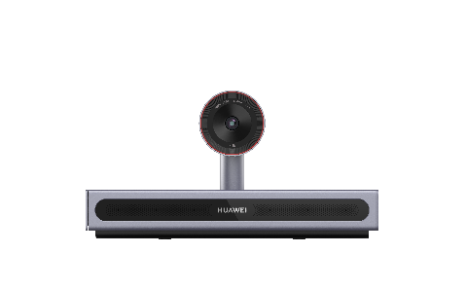


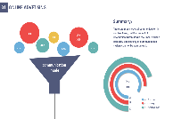



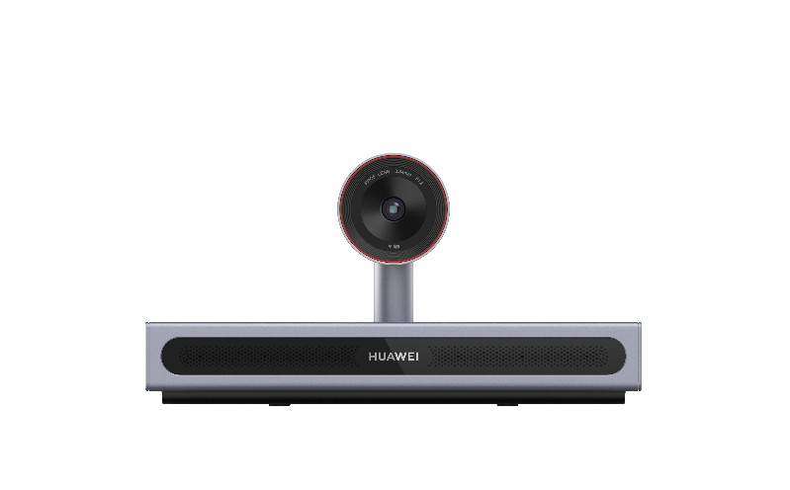
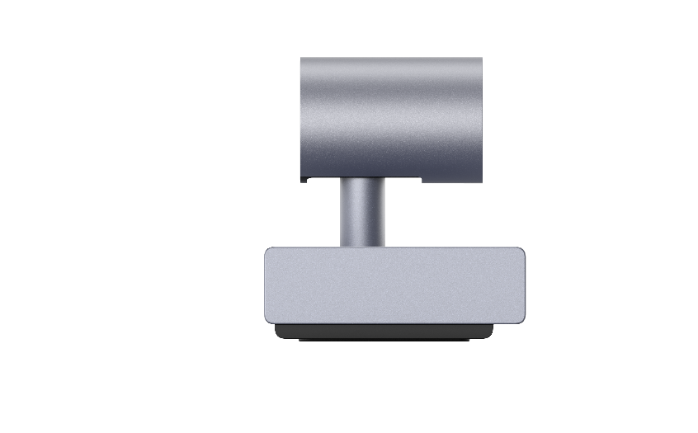
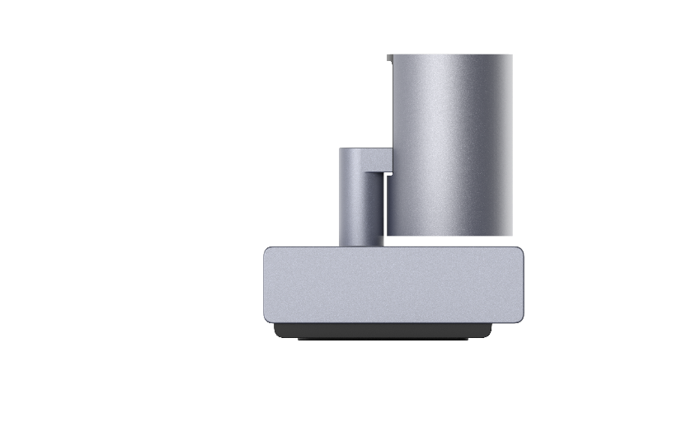
Highlights
HD Video and Auto-Framing
Features a 4K professional camera and supports Auto-Framing and intelligent speaker centering.
Huawei's proprietary VME technology removes noise from motion images, for enhanced video quality.
H.265 1080p multistream conferences, allowing endpoints to encode and decode multiple channels of streams in different formats at the same time, and users to flexibly adjust the continuous presence layout and view any site.
BYOM
Bring Your Own Meeting (BYOM), allowing you to invoke the camera, microphone, external display, and speaker of the Bar 210 after initiating or joining in a cloud conference on the PC to have better conference experience
Support for wired screen projection via Type-C
Type-C
Hi-Fi Audio
The built-in microphone array features an 8 m sound pickup distance and uses intelligent algorithms to ensure lossless voice pickup, encoding, decoding, and transmission.
Opus + NetATE + AJB, to ensure 80% PLC for audio
Crystal clear audio, with acoustic echo cancellation (AEC), automatic noise gain (ANG), and automatic gain control (AGC)
Audio multistreaming, enabling endpoints to decode multiple channels of audio streams at the same time, mix them, and output them, to reduce platform resource consumption
Easy Operations
90°
Manual mechanical PTZ camera with 3x digital zoom, covering every corner of the conference room
Comes with a next-generation remote control for effortless operation

Slide 4

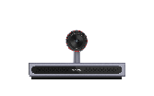
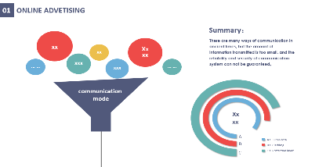

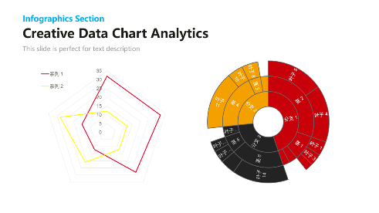
Application Scenarios
Business Conferences
Integrated deployment
Pristine audio and video
Seminars
Local projection
Versatile remote conferencing tool

Slide 5
Features
Functions and Features
HD video | H.265 is used as the encoding and decoding protocol for both video and content, together with Huawei's proprietary Video Motion Enhancement (VME), to deliver 1080p video of 60 fps and 4K content sharing experience. Intelligent detection and backend image enhancement to adapt to WDR illumination, reduce bandwidth consumption, improve image definition, and enhance motion images.
Hi-Fi audio | Acoustic Echo Cancellation (AEC), Automatic Noise Suppression (ANS), Automatic Gain Control (AGC), VoiceClear, AudioEnhancer, and lip synchronization. Opus, Forward Error Correction (FEC), Backward Error Correction (BEC), Packet Loss Concealment (PLC), Net Automatic Transfer-Enhancement (netATE), and Audio Jitter Buffer (AJB). Built-in microphone array with 8-meter sound pickup, and external microphone array for an extended sound pickup range, to deliver clear, crisp audio of speakers.
Auto-Framing | In Auto-Framing mode, the 4K professional camera with 3x digital zoom automatically centers all participants in the frame, ensuring an optimal viewing experience.
Multistream conference | With the H.265 1080p multistream video capability of the product, users can adjust the continuous presence layout and seamlessly view any site. In addition, platform resource consumption and video conference delay are minimized, allowing for the access of a large number of endpoints. The multistream audio capability enables the endpoint to adapt to multiple sampling rates and decode multiple audio streams concurrently and mix them for output, effectively reducing platform resource consumption.
BYOM | After initiating or joining a cloud conference on a PC, you can connect to the Bar 210 via a USB Type-C cable to use its camera, microphone, external monitor, and speaker. This transforms a small-screen meeting into a professional conference experience with a wide viewing angle and long-range sound pickup, ensuring clearer visuals and audio.
Banner/Caption | Supports sending and receiving banners and captions via T.140 signaling.
Multi-point conference recording | Supports SVC conference recording, enables scheduling of multi-point recording conferences via SiteCall, and provides pause/resume control during recording.
Multiple layouts | Video and other content displayed in separate panes
Network adaptability | Super Error Concealment (SEC) and Hybrid Automatic Repeat Request (HARQ) retransmission ensure smooth, clear video, even at a 50% packet loss rate.
Independent core technologies | Huawei's proprietary core technologies, and high-computing hardware platform architecture for powerful performance. Each device is equipped with a preconfigured certificate during manufacturing, to prevent spoofing and hijacking. Audio watermarks are seamlessly embedded into every frame of the audio data, with the watermark field being the site number. In cases where there is no site number available, the watermark field is replaced by the IP address. If the conference audio is recorded and shared without authorization, the intercepted audio clip can be analyzed to extract the watermarks and trace the source of the leakage. Standout audio and video technologies: audio and video capability enhancement, H.264/H.265, QoS network optimization technology, anti-feedback technology, and active noise suppression algorithm

Slide 6
Specifications
Components
HD codec (built-in HD camera and microphone array), remote control, cables, and power supply
Standards & Protocols
Multimedia framework protocols | ITU-T H.323 and IETF SIP | ITU-T H.323 and IETF SIP
Video codec protocols | H.265, H.265 SVC, H.264 HP, H.264 BP, H.264 SVC, H.263, and H.263+ | H.265, H.265 SVC, H.264 HP, H.264 BP, H.264 SVC, H.263, and H.263+
Audio encoding and decoding protocols | Opus, AAC-LD, G.729A, G.722, G.722.1C, G.711U, G.711A and G.719 | Opus, AAC-LD, G.729A, G.722, G.722.1C, G.711U, G.711A, and G.719
Dual-stream protocols | ITU-T H.239, IETF BFCP, and data | ITU-T H.239, IETF BFCP, and data
Other communication protocols | H.225, H.235, H.241, H.245, H.281, H.350, H.460, RFC2833, LDAP | H.225, H.235, H.241, H.245, H.281, H.350, H.460, RFC2833, LDAP
Network transmission protocols | TCP/IP, RTP, RTCP, DHCP, DNS, SMTP, SNMP, SNTP, SSH, HTTP, HTTPS, and TR-069 | TCP/IP, RTP, RTCP, DHCP, DNS, SMTP, SNMP, SNTP, SSH, HTTP, HTTPS, and TR-069
Video Features
Video resolution | H.264 1080p 30 fps (min. bandwidth: 512 kbit/s) 720p 30 fps (min. bandwidth: 384 kbit/s) |  | 720p 60 fps (min. bandwidth: 768 kbit/s) 4SIF/4CIF (min. bandwidth: 128 kbit/s)
 | H.265 1080p 30 fps (min. bandwidth: 384 kbit/s) 720p 30 fps (min. bandwidth: 256 kbit/s) |  | 720p 60 fps (min. bandwidth: 512 kbit/s)
4K professional-grade camera | 3x digital zoom, F1.8 aperture Pan angle of the manual PTZ: ±100° Tilt angle of the manual PTZ: –90° to +30°
Presentation resolution | HDMI input: 640 x 480 at 60/72/75/85 fps, 800 x 600 at 56/60/72/75/85 fps, 1024 x 768 at 60/70/75/85 fps, 1152 x 864 at 60/75/85 fps, 1280 x 600 at 60 fps, 1280 x 720 at 60/75/85 fps, 1280 x 768 at 60/75/85 fps, 1280 x 800 at 60/75/85 fps, 1280 x 960 at 60/75/85 fps, 1280 x 1024 at 60/75/85 fps, 1360 x 768 at 60 fps, 1366 x 768 at 60 fps, 1440 x 900 at 60 fps, 1400 x 1050 at 60 fps, 1600 x 900 at 60 fps, 1600 x 1200 at 60 fps, 1680 x 1050 at 60 fps, 1920 x 1080 at 24/25/30/50/60 fps, 1920 x 1200 at 60 fps, 3840 x 2160 at 25/30 fps Codec resolution: CIF (352 x 288), 640 x 480, 4CIF (704 x 576), 800 x 600, 1024 x 768, 720p (1280 x 720), 1280 x 1024, 448p (768 x 448), 1080p (1920 x 1080), 1600 x 1200, 1920 x 1200, 1152 x 864, 1280 x 600, 1280 x 768, 1280 x 800, 1280 x 960, 1360 x 768, 1366 x 768, 1440 x 900, 1400 x 1050, 1600 x 900, 1680 x 1050, 2048 x 1152, 2048 x 1236, 2048 x 1536, 2048 x 1556, 2560 x 1440, 2560 x 1600, 2560 x 2048, 2880 x 1620, 2880 x 1800, 3200 x 1800, 4K (3840 x 2160), 1080i 50/60 fps Outputs: 1920 x 1080, 3840 x 2160
Dual-stream resolution | 1080p 30 fps + 1080p 30 fps (4K8)
Other video features | Display modes such as Picture in Picture (PiP) and Picture out Picture (PoP) Video Motion Enhancement (VME) Video Intensiﬁer View Processing
Audio features | AEC, ANS, AGC, VoiceClear, AudioEnhancer, and lip synchronization
Security and Stability
Network adaptability | IPv4 and IPv6, SEC, ARQ, FEC, and PLC
Security management | H.235/TLS for signaling encryption and SRTP for media encryption Meeting access password, meeting control password, and administrator password) Support for AES256 encryption algorithm for media streams of SIP/H.323 calls 90° downward camera rotation for physical privacy protection

Slide 7
Specifications
Ports
Audio input ports | Built-in microphone array 1 x 3.5 mm 1 x HD-AI (level 2) 1 x HDMI (audio) 1 x TYPE-C (audio)
Audio output ports | 1 x 3.5 mm 2 x HDMI (audio)
Video input ports | 1 x built-in camera (1-channel PTZ digital zoom) 1 x HDMI (4K30, audio input supported) 1 x Type-C (4K30, audio input supported)
Video output port | 1 x HDMI (4K60, audio output supported) 1 x HDMI (4K60, video source: 30 fps)
Other ports | 1 x USB 3.0 Type-A | 1 x RJ45 (without PoE, 10/100/1000 Mbit/s LAN)
Conferencing Features
Languages | English, Simplified Chinese, Traditional Chinese, French, Spanish, Japanese, Russian, Portuguese, Italian, Arabic, Thai, Turkish, Bulgarian, Kazakh, Korean, Serbian, and Sinhala
Features | · Conference control via the web interface and remote control · Bring Your Own Meeting (BYOM) · Web-based remote browsing · SiteCall · Auto-Framing · Address book import and export · SVC recording · T.140 banner/caption | · Remote camera control · Multistream conference · HD image snapshot (16:9 and 4:3) · PiP (small window: 1/16 of the main window in size and adjustable position) · LDAP address book · Wallpaper settings · Open APIs for third-party integration · Output port priority configuration
Bandwidth | 64 kbit/s to 8 Mbit/s
Maintenance
Method | Terminal NMS: SNMP and TR-069 Web security management: built-in web server and graphical maintenance and diagnosis
Features | · Auto sleep and wake-up · Event log record, query, and export · Restoration to factory defaults · Embedded loopback: local self-loop · Embedded audio and video testing
Physical Specifications
Dimensions (H x W x D) | Product dimensions: 157.5 mm x 308 mm x 145 mm Packaging dimensions: 275 mm x 575 mm x 260 mm Net weight: 2.2 kg Gross weight: 4.7 kg
Electrical features | Operating voltage: 100 V to 240 V AC Operating frequency: 50 Hz to 60 Hz Maximum power consumption: 46 W
Environment requirements | Temperature: 0°C to 40°C (operating state), –40°C to +70°C (non-operating state) Relative humidity: 10% to 95% (operating state), 5% to 95% (non-operating state) Ambient noise: < 46 dBA SPL Minimum illuminance: 7 lux Recommended illuminance: > 200 lux
Certification and standards | CQC, CE, VCCI, Network Access License of MIIT, and HDMI

Slide 8
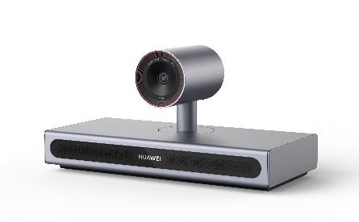


Ordering Information
Product Name | Model | Product Picture
Bar 210 video conferencing endpoint | Bar 210
Learn More>>>
Huawei Intelligent Collaboration Official Account
Huawei Intelligent Collaboration Official Website
Trademarks and Permissions
is a trademark or registered trademark of Huawei Technologies Co., Ltd. Other trademarks, products, services and company names mentioned are the property of their respective owners.
Disclaimers
The technical specifications described in this document include, but are not limited to, parameters and performance indicators and may vary depending on the actual release. This document does not constitute a warranty of any kind, expressed or implied. Huawei reserves the right to update or correct information regarding our products or solutions. You can find detailed information about updates in the latest release notes or introduction.
Copyright © Huawei Technologies Co., Ltd. 2025. All rights reserved. No part of this document may be reproduced or transmitted in any form or by any means without prior written consent of Huawei Technologies Co., Ltd.
Huawei Technologies Co., Ltd.
Bantian, Longgang District, Shenzhen
Tel: 86-755-28780808
Post code: 518129
www.huawei.com
Revised: June 2025

