Slide 1


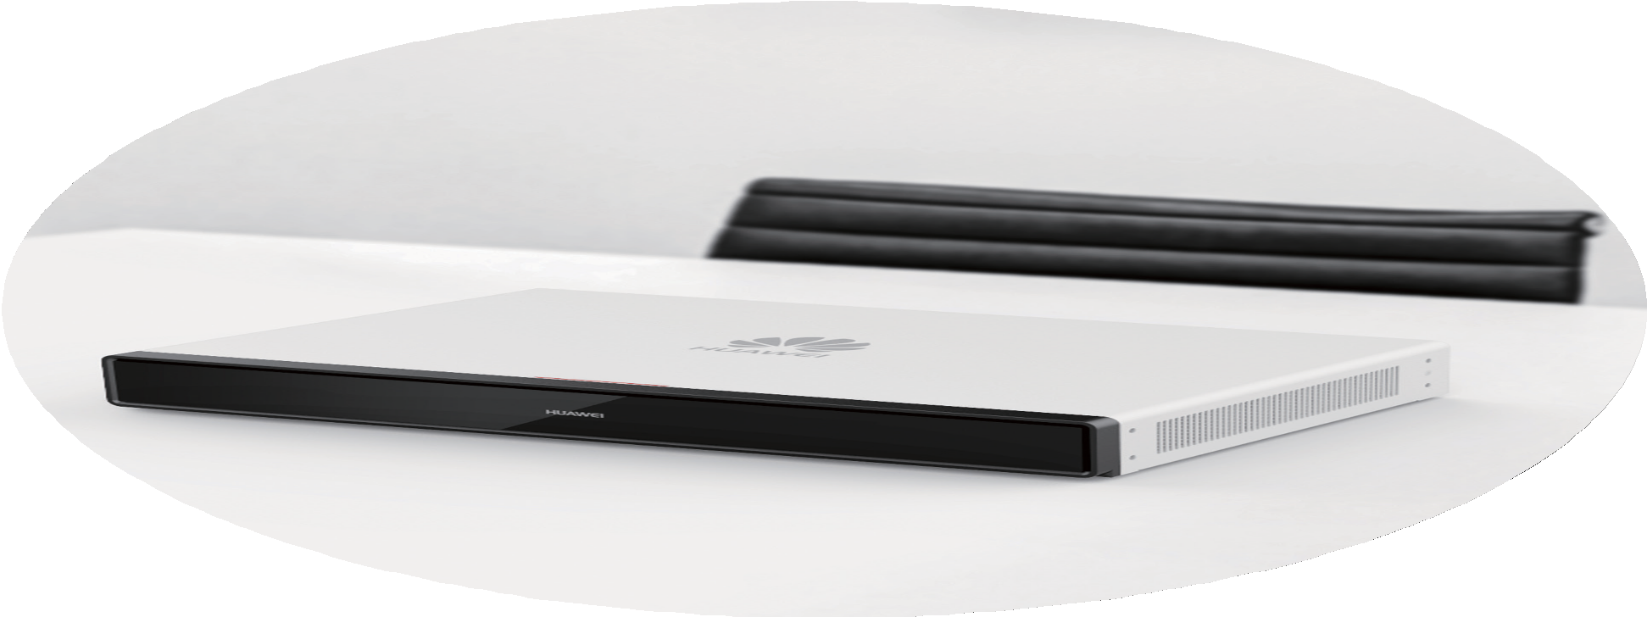
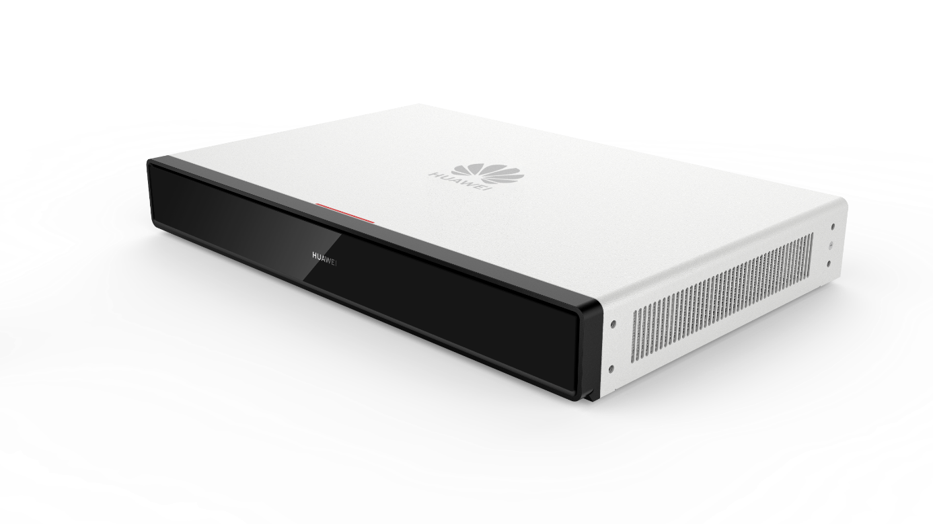



HUAWEI CloudLink Collaborative Telepresence Endpoints
Eliminate Time and Space Limitations | Connect Teams | Ignite Creativity
CloudLink Box 310/610
Ultra-HD Video Conferencing Endpoint

Slide 2


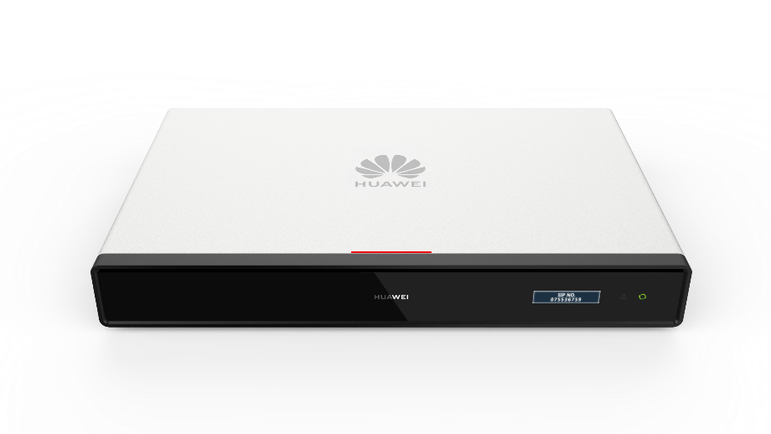




















HUAWEI CloudLink Box 310 and CloudLink Box 610 are next-gen ultra-HD video conferencing endpoints built on Huawei's proprietary core technologies and high-computing hardware platform architecture. The Box 310 and Box 610 are equipped with H.265 4K dual-stream audio and video media processing capabilities and extensive audiovisual ports. It is compatible with a variety of cameras and display devices for meeting rooms of all sizes.
Next-gen hardware platform with independent core technologies
4K 30 fps video + content, H.265 encoding and decoding
CloudLink Box 310/610
Ultimate Performance.
Unlimited Scalability.
An extensive range of ports for fast integration in meeting rooms
Security and Reliability
Huawei's proprietary core technologies and high-computing hardware platform architecture for powerful performance
Invisible watermarks embedded seamlessly into conference audio; anti-attack watermark extraction for audio leakage tracing
One certificate for one endpoint, preventing device hijacking and spoofing
End-to-end encryption and media and signaling encryption measures, such as H.235 and SRTP/TLS, ensuring meeting information security
Professional-Grade Ultra-HD
H.265 hardware codec + Huawei's proprietary video motion enhancement (VME) technology, effectively removing noises from moving images and delivering 4K ultra-HD videos with natural colors
H.265 4K multistream conferences, enabling endpoints to encode and decode multiple channels of video streams in different formats at the same time and allowing users to flexibly adjust the continuous presence layout and view any site
Powerful network adaptability and 30% video packet loss concealment

Slide 3



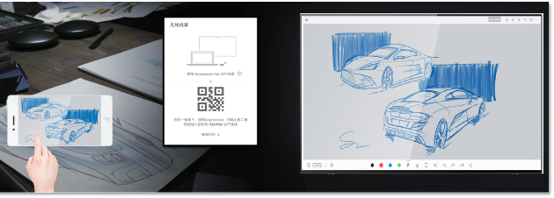


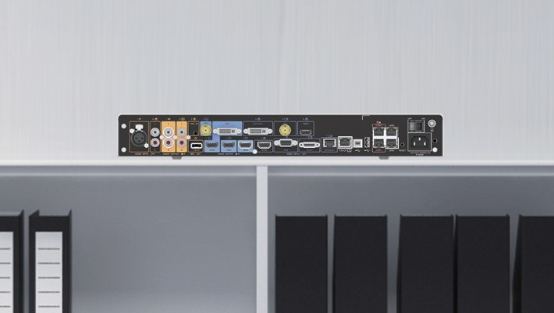
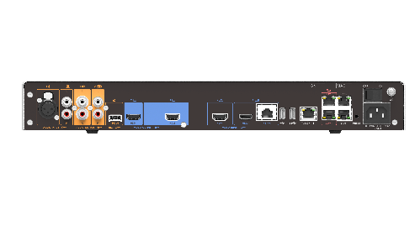

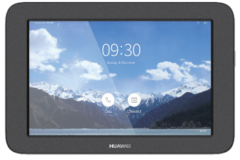
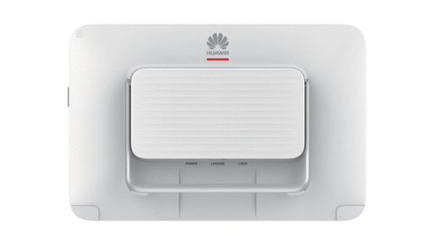
Hi-Fi Audio
Supreme audio built on acoustic echo cancellation (AEC), automatic noise gain (ANG), and automatic gain control (AGC)
Audio multistreaming, enabling endpoints to decode multiple channels of audio streams at the same time, mix them, and output them, to reduce platform resource consumption
Opus+NetATE+AJB for clear and smooth voice even when the packet loss rate reaches 80%
Omnidirectional microphone cascading, enhancing long-distance sound pickup
Remote Sharing
4K remote sharing with ultra-HD content
Wired and wireless projection modes
One-tap wireless sharing from a PC or mobile phone, avoiding complex cabling
Flexible Adaptation
Mainstream audio and video ports, which can be connected to the microphone array, loudspeaker, projector, and LCD/LED large-screen display device
All-in-one HT-RX port integrates video transmission, camera control, and power supply with up to 100-meter long-distance connection
Easy Operations
A 10.1-inch Touch is available, which is stylish and easy to use
User-friendly GUI
PoE power supply and a Kensington security slot

Slide 4


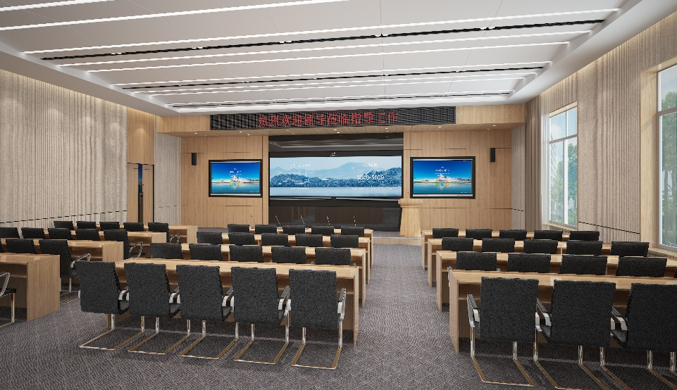

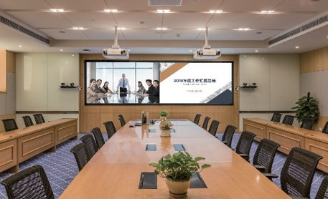

Flexible Application Scenarios
Box + UHD Camera
Supreme HD audio and video, and speaker center positioning
Business Meeting Room
Box + 4K camera + large screen
Present every detail perfectly in large conference rooms
Lecture Hall
2022 YEARLY WORK REPORT
Box + UHD Camera
Multi-level protection, high security and reliability
Administrative Meeting Room

Slide 5
Product Features
Features and Functions
H.265-based encoding and decoding for both video and content delivers 4K UHD video effects with breathtaking colors for an immersive meeting experience.
Intelligent face detection and backend image processing enhance light adaptability and reduce bandwidth consumption, providing quality image definition and motion enhancement.
Ultra-HD video
Hi-Fi audio
Acoustic Echo Cancellation (AEC), Automatic Noise Suppression (ANS), Automatic Gain Control (AGC), VoiceClear, AudioEnhancer, and lip synchronization.
Intelligent content sharing
Wired and wireless presentation
4K ultra-HD content sharing
With the H.265 4K multistream video capability of the product, users can adjust the continuous presence layout and seamlessly view any participant. In addition, platform resource consumption and video conference delay are minimized, allowing for the access of a large number of endpoints.
The multistream audio capability enables the endpoint to adapt to multiple sampling rates and decode multiple audio streams concurrently and mix them for output, effectively reducing platform resource consumption.
Multistream conferencing
Convenient control
10.1-inch touch panel supports PoE power supply with user-friendly GUI.
BYOM (Bring Your Own Meeting)
Banner/Caption
Supports sending and receiving banners and captions via T.140 signaling.
Multi-point conference recording
Supports SVC conference recording, enables scheduling of multi-point recording conferences via SiteCall, and provides pause/resume control during recording.
Multiple layouts
Video and content can be displayed on one screen, but in different panes.
Super Error Concealment (SEC) and Hybrid Automatic Repeat Request (HARQ) retransmission deliver clear and smooth video even when the packet loss rate reaches 30%.
Opus ensures clear and smooth audio even when the audio packet loss rate reaches 80%.
Forward Error Correction (FEC), Backward Error Correction (BEC), Packet Loss Concealment (PLC), Net Automatic Transfer-Enhancement (netATE), and Audio Jitter Buffer (AJB).
Network adaptability
Audio watermarks are seamlessly embedded into every frame of the audio data, with the watermark field being the site number. In cases where there is no site number available, the watermark field is replaced by the IP address. If the conference audio is recorded and shared without authorization, the intercepted audio clip can be analyzed to extract the watermarks and trace the source of the leakage.
Each device is equipped with one certificate preset during manufacturing, effectively preventing spoofing and hijacking.
Security and reliability
Huawei's proprietary core technologies and high-computing hardware platform architecture for powerful performance.
Core audiovisual technologies: audio and video capability enhancement, H.264/H.265/super-resolution technology, QoS network optimization technology, anti-feedback technology, and active noise suppression algorithm.
Independent core technologies
Openness
Open APIs for third-party integration

Slide 6

Components
Ultra-HD codec, ultra-HD camera (optional), microphone array (optional), Touch panel, cables, and power adapter
Communications Protocols
Multimedia frame protocols
ITU-T H.323 and IETF SIP
Video codec protocols H.265, H.265 SVC, H.264 HP, H.264 BP, H.264 SVC, H.263, H.263+
Audio codec protocols G.711A, G.711U, G.722, G.722.1C, G.729A, G.719, AAC-LD, and Opus
Dual-stream protocols ITU-T H.239, IETF BFCP
Other communication protocols
H.225, H.235, H.241, H.245, H.350, H.460, RFC2833, LDAP
Network transmission protocols
TCP/IP, RTP, RTCP, DHCP, DNS, SMTP, SNMP, SNTP, SSH, HTTP, HTTPS and TR-069
Video Features
HDMI input: 640 x 480 60/72/75/85 fps, 800 x 600 56/60/72/75/85 fps, 1024 x 768 60/70/75/85 fps, 1152 x 864 60/75/85 fps, 1280 x 600 60 fps, 1280 x 720 60/75/85 fps, 1280 x 768 60/75/85 fps, 1280 x 800 60/75/85 fps, 1280 x 960 60/75/85 fps, 1280 x 1024 60/75/85 fps, 1360 x 768 60 fps, 1366 x 768 60 fps, 1440 x 900 60 fps, 1400 x 1050 60 fps, 1600 x 900 60 fps, 1600 x 1200 60 fps, 1680 x 1050 60 fps, 1920 x 1080 24/25/30/50/60 fps, 1920 x 1200 60 fps, 3840 x 2160 25/30/50/60 fps
Presentation resolution
Codec resolution: CIF (352 x 288), 640 x 480, 4CIF (704 x 576), 800 x 600, 1024 x 768, 720p (1280 x 720), 1280 x 1024, 448p (768 x 448), 1080p (1920 x 1080), 1600 x 1200, 1920 x 1200, 1152 x 864, 1280 x 600, 1280 x 768, 1280 x 800, 1280 x 960, 1360 x 768, 1366 x 768, 1440 x 900, 1400 x 1050, 1600 x 900, 1680 x 1050, 2048 x 1152, 2048 x 1236, 2048 x 1536, 2048 x 1556, 2560 x 1440, 2560 x 1600, 2560 x 2048, 2880 x 1620, 2880 x 1800, 3200 x 1800, 4K (3840 x 2160)
Outputs: 1920 x 1080, 3840 x 2160
Picture-in-picture (PiP) and picture out picture (PoP) display modes
Video Motion Enhancement (VME)
Video Intensifier
View Processing
Other video features
Audio features
Acoustic Echo Cancellation (AEC), Automatic Noise Suppression (ANS), Automatic Gain Control (AGC), VoiceClear, AudioEnhancer, and lip synchronization
Meeting Features
English, Simplified Chinese, Traditional Chinese, French, Spanish, Japanese, Russian, Portuguese, Italian, Arabic, Thai, Turkish, Bulgarian, Kazakh, Korean, Serbian, and Sinhala
Languages
Conference control via the web interface and remote control
Bring Your Own Meeting (BYOM)
Web-based remote browsing
SiteCall
Auto-Framing
Address book import and export
SVC recording
T.140 banner/caption
Remote camera control
Multistream conference
HD image snapshot (16:9 and 4:3)
PiP (small window: 1/16 of the main window in size and adjustable position)
LDAP address book
Wallpaper settings
Open APIs for third-party integration
Output port priority configuration
Features
Security and Stability
Network adaptability
IPv4 and IPv6, DiffServ, and URI call
Super Error Concealment (SEC), Automatic Repeat Request (ARQ), Forward Error Correction (FEC), Intelligent Rate Control (IRC), and Packet Loss Concealment (PLC)
Network Security
H.235/TLS for signaling encryption
SRTP media encryption
Conference access password, conference control password, and administrator password
Dual-stream encryption
Firewall traversal H.460 public-private network traversal, static NAT
Environment requirements
Temperature: 0℃ to 40℃ (operating state) -40℃ to +70℃ (non-operating state)
Relative humidity: 10% to 95% RH (operating state) 5% to 95% RH (non-operating state)
Ambient noise: < 46 dBA SPL
Certification and standards
CQC, CE (RoHS, REACH, and WEEE), Network Access License of MIIT, and Radio Type Approval Certification

Slide 7
Feature
Model
Box 310
Box 610
Positioning
Business model
Professional-grade model
Usage
Small and medium-sized meeting rooms
Medium and large meeting rooms
H.264
1080p 60 fps at 1 Mbit/s
1080p 30 fps at 512 kbit/s
720p 60 fps at 768 kbit/s
720p 30 fps at 384 kbit/s
H.265
4K 30 fps at 2 Mbit/s
1080p 60 fps at 768 kbit/s
1080p 30 fps at 384 kbit/s
720p 60 fps at 512 kbit/s
720p 30 fps at 256 kbit/s
H.264
1080p 60 fps at 1 Mbit/s
1080p 30 fps at 512 kbit/s
720p 60 fps at 768 kbit/s
720p 30 fps at 384 kbit/s
H.265
4K 30 fps at 2 Mbit/s
1080p 60 fps at 768 kbit/s
1080p 30 fps at 384 kbit/s
720p 60 fps at 512 kbit/s
720p 30 fps at 256 kbit/s
Video resolution
Dual-stream capability
1080p 30 fps + 1080p 30 fps
1080p 60 fps + 1080p 60 fps
4K 30 fps + 4K 30 fps
1080p 30 fps + 1080p 30 fps
1080p 60 fps + 1080p 60 fps
4K 30 fps + 4K 30 fps
Video input
1 x HT-RX
2 x HDMI
1 x HT-RX
3 x HDMI
Video output
2 x HDMI
3 x HDMI
Audio input
1 x HD-AI (level 2)
1 x XLR connector
2 x HDMI (audio input)
2 x RCA
1 x HD-AI (level 2)
1 x XLR connector
3 x HDMI (audio input)
2 x RCA
Audio output
4×RCA
1 x HDMI (audio output)
4×RCA
1 x HDMI (audio output)
1 x USB 2.0 Type-A
1 x USB 3.0 Type-A
2 x 10/100/1000 Mbit/s LAN
1 x PoE network port (Touch)
2 x RJ45 serial port
1 x Wi-Fi (built-in)
1 x USB 2.0 Type-A
1 x USB 3.0 Type-A
2 x 10/100/1000 Mbit/s LAN
1 x PoE network port (Touch)
2 x RJ45 serial port
1 x Wi-Fi (built-in)
Other ports
Microphone cascading
2
2
Bandwidth
IP: 64 kbit/s to 8 Mbit/s
IP: 64 kbit/s to 8 Mbit/s
Dimensions
Endpoint: 442 mm x 58 mm x 285 mm
Package: 580 mm x 205 mm x 380 mm
Net weight: 4.2 kg
Gross weight: 8.1 kg
Endpoint: 442 mm x 58 mm x 285 mm
Package: 580 mm x 205 mm x 380 mm
Net weight: 4.2 kg
Gross weight: 8.1 kg
Electrical features
Working voltage: 100 V to 240 V AC
Working frequency: 50 Hz to 60 Hz
Max. power consumption: 100 W
Embedded AC/DC power module
Working voltage: 100 V to 240 V AC
Working frequency: 50 Hz to 60 Hz
Max. power consumption: 100 W
Embedded AC/DC power module
* The technical specifications described in this document include but are not limited to parameters and performance indicators and vary depending on the actual release.

Slide 8





Product Name
Product Model
Sample Photo
HUAWEI CloudLink Box 310
Box 310
HUAWEI CloudLink Box 610
Box 610
1080P30-to-1080P60 Codec Software License
1080P60-to-4K30 Codec Software License
1080P30-to-4K30 Codec Software License
-
-
-
Learn More>>>
Huawei Intelligent Collaboration Official Account
Huawei Intelligent Collaboration Website
Copyright © Huawei Technologies Co., Ltd. 2024. All rights reserved.
No part of this document may be reproduced or transmitted in any form or by any means without the prior written consent of Huawei Technologies Co., Ltd.
Trademarks and Permissions
, , and are trademarks or trade names of Huawei Technologies Co., Ltd. All other trademarks, product names, service names, and company names mentioned in this document are the property of their respective holders.
Disclaimer
The technical specifications described in this document include but are not limited to parameters and performance indicators and vary depending on the actual release. This document does not constitute a warranty of any kind, expressed or implied. Huawei may update relevant information from time to time. Huawei reserves the right to update or correct the information about related products or solutions. Updates are described in detail in the latest release notes or introduction.
Huawei Technologies Co., Ltd.
Huawei Industrial Base, Bantian, Longgang
Tel: +86 755 28780808
Postal code: 518129 www.huawei.com
Updated: June 2025

