Slide 1
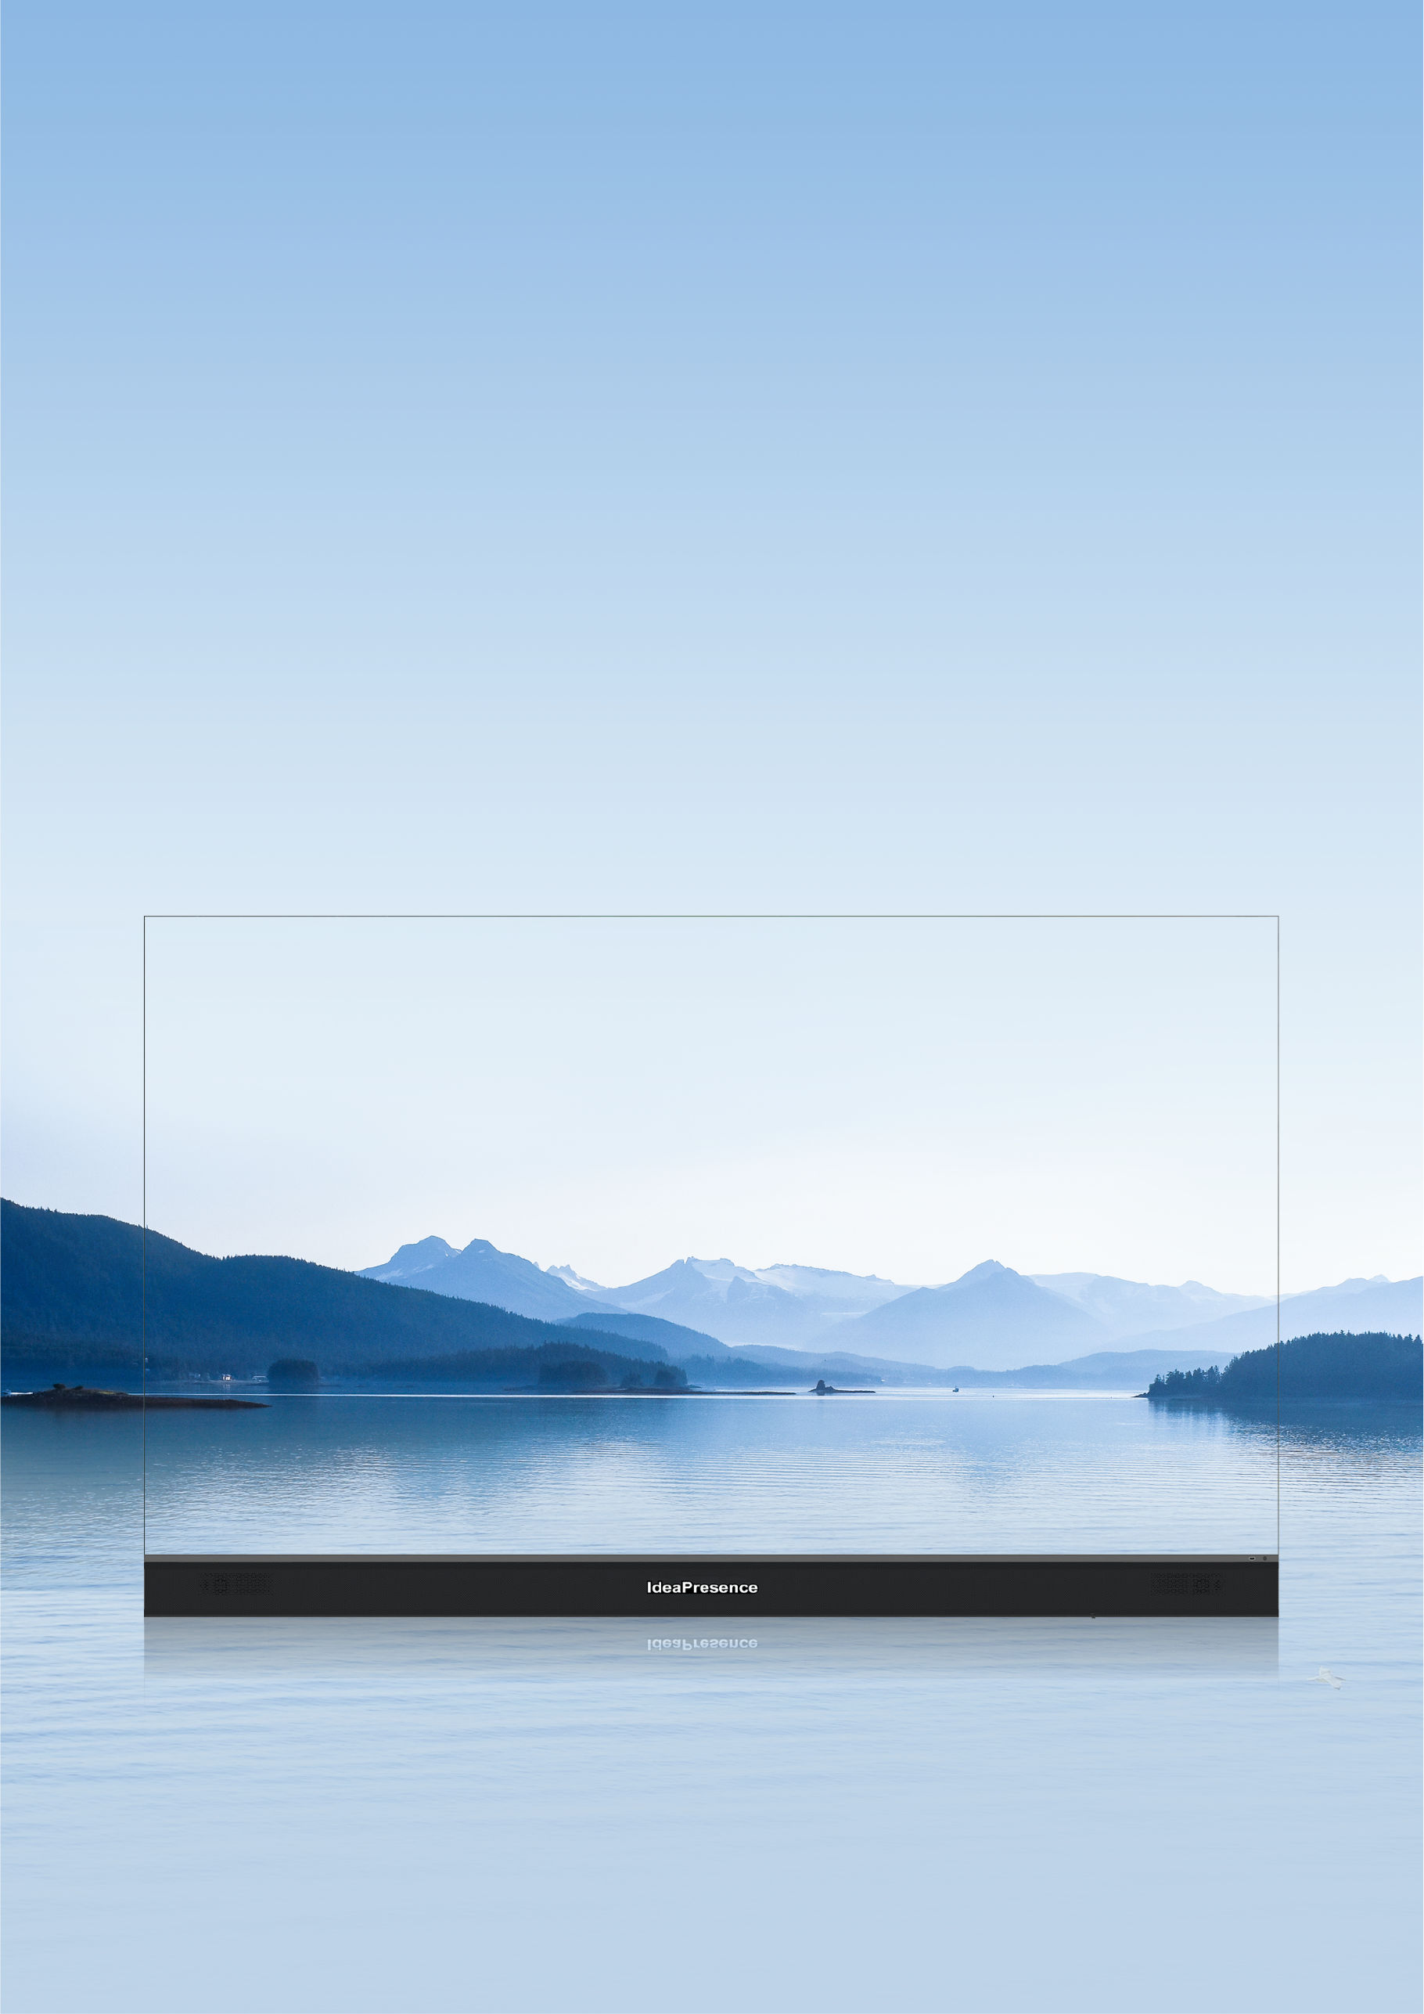
IdeaPresence
Immerse Yourself in Infinity
Cool-running COB display | Immersive audiovisual experience | Professional executive meetings

Slide 2


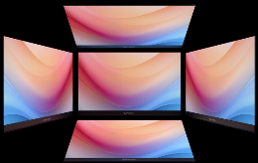
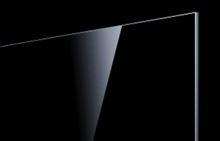
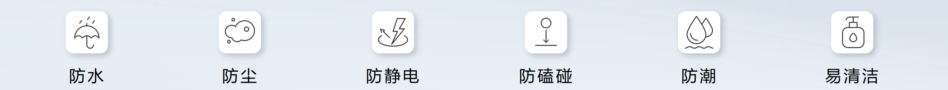
IdeaPresence
The 138-inch 4K immersive giant display adopts the flip-chip COB technology and has a 20,000:1 contrast ratio and BT.2020 color gamut for realistic color reproduction. It also boasts two groups of full-range speakers for stereo surround sound. The intelligent audio and video provide a professional meeting experience¹, making it suitable for large meeting rooms, lecture halls, and multi-functional halls.
Expand Your View, Expand Your World
Stunning minimalist design
The display's frame is made of aviation-grade aluminum alloy and has undergone wire-drawing and oxidation, for great stability and durability. The chin of the display boasts speaker cloth technology, which makes it resistant to dust and dirt. What's more, users can enjoy widescreen while watching videos thanks to 170° wide viewing angle and thin edges on three of its sides.
99.5%
Screen-to-body ratio on three sides
2 mm
Ultra-narrow bezel
170° wide viewing angle
No light reflection or leakage from the side
≤ 0.1 mm
Flat mirror-like surface
Cool-running COB display
We use new architecture in our static low-power driver IC and adopt the co-cathode design to provide precise power supply and reduce power consumption by 30%. Additionally, screen temperature rise does not exceed 17°C², ensuring viewing experience is not hindered by overheating.
Rock-solid security protection
Flip-chip COB technology safeguards internal components by preventing their exposure. Its front is IP65-rated, and any smudges on the surface can be easily cleaned.
Waterproof
Dustproof
Anti-static
Bump-proof
Moisture-proof
Easy to clean
Extension for bigger possibilities
The modular array design allows for dual-screen extension and 32:9 aspect ratio, enabling simultaneous display of site video and shared content.
Notes:
完整16bit灰度等级
灰度等级是指LED显示屏单基色亮度中从最暗到最亮之间能区别的亮度级数。灰度是显示色彩数的决定因素。一般而言灰度等级越高，显示的色彩越丰富，明暗之间的过渡越自然，画面也越细腻，更易表现丰富的细节。目前市场上的高端LED显示屏产品均标称为16bit灰度等级（意即每个LED灯可表达2的16次方即65536种颜色）。但实际中，绝大多数厂商是实现不了上述灰度等级的，其原因在于，当刷新频率达到400Hz以上时，驱动电路带宽和数据传输带宽均趋近于理论极限，必须牺牲掉部分灰度等级来获得较高的刷新频率，这就使得显示屏黑色部分灰度不足，无法表现细节。
【清晰】4K显示
【清晰】刷新率，64Gray以上：64 Gray表示屏幕很暗的时候感受不到刷新，其他友商的刷新率是在亮度高的情况下
【层次】20000:1对比度
【层次】墨色一致性：△E*ab ＜ 0.5 更黑
【层次】灰度等级≥16bit：16bit灰度等级，明暗过渡自然，，画质更细腻，细节还原更精准
【色彩】色域：10.7亿绚丽色彩，≥85% BT.2020色域，画面色彩更加接近人眼真实世界观感
【护眼】AG防炫处理：采用AG防眩技术，减轻灯光与阳光照射屏幕对画面的干扰，无惧反光，让图像更清晰，人眼观看更舒适
【护眼】低蓝光认证：获得德国莱茵低蓝光认证，有效降低部分有害蓝光，呵护双眼
【护眼】亮度校正和颜色校正（待定）：出厂前亮度、色彩逐台校准
BT2020、反射率、3840Hz

Slide 3




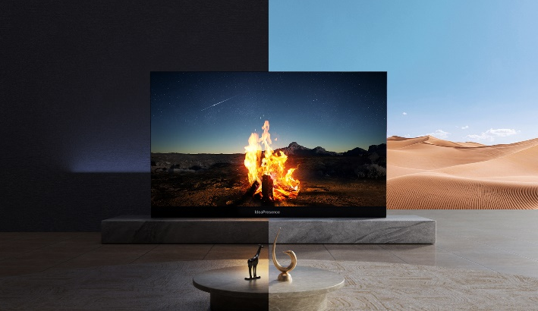
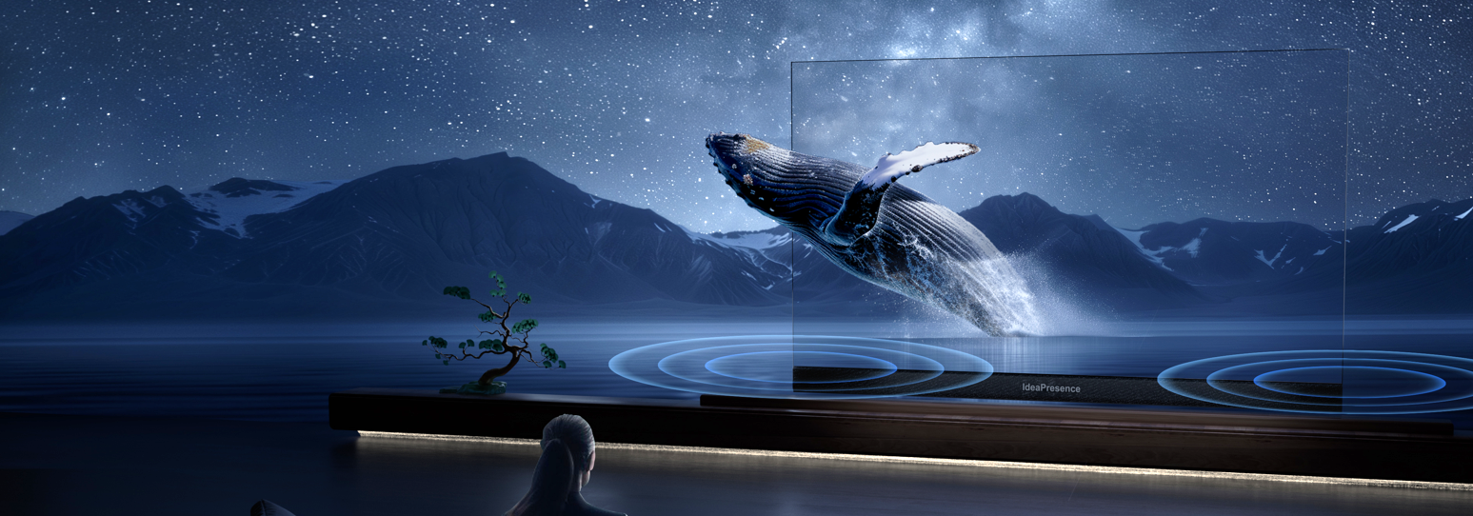



Immersive Audiovisual Experience
Ultimate 4K visual fidelity
The display has a P0.7 pixel spacing and a pixel pitch of 32 ppi, with support for independent self-luminance for hundreds of millions of pixels. Each beam of light can be precisely adjusted to enhance image presentation and vividness.
Colors beyond the palette
The display can present 1.07 billion stunning colors with BT.2020 image-level color gamut, providing 64 times higher color display performance. Professional color adjustment before delivery creates true-to-life images, bringing you closer to reality.
Pure color that withstands light
The display's surface is processed with nanometer-level technology, producing pure black color that does't reflect light. The screen feels smooth and flat, leaving behind no smudges.
High black uniformity
Anti-glare/reflection
No smudges
Optimal brightness, day or night
The screen boasts a peak brightness of 1000 nits, a 16-bit gray scale level, and rich dimming levels, for all-round protection against ambient light.
Theater-quality stereo audio
With two high-power full-range built-in speakers, the display delivers impactful and high-quality audio, providing an immersive experience for users.
60 Hz to 20 kHz
Clear voices
2X subwoofer
Powerful bass
Max. 95 dB volume
Open sound field
Notes:
完整16bit灰度等级
灰度等级是指LED显示屏单基色亮度中从最暗到最亮之间能区别的亮度级数。灰度是显示色彩数的决定因素。一般而言灰度等级越高，显示的色彩越丰富，明暗之间的过渡越自然，画面也越细腻，更易表现丰富的细节。目前市场上的高端LED显示屏产品均标称为16bit灰度等级（意即每个LED灯可表达2的16次方即65536种颜色）。但实际中，绝大多数厂商是实现不了上述灰度等级的，其原因在于，当刷新频率达到400Hz以上时，驱动电路带宽和数据传输带宽均趋近于理论极限，必须牺牲掉部分灰度等级来获得较高的刷新频率，这就使得显示屏黑色部分灰度不足，无法表现细节。
【清晰】4K显示
【清晰】刷新率，64Gray以上：64 Gray表示屏幕很暗的时候感受不到刷新，其他友商的刷新率是在亮度高的情况下
【层次】20000:1对比度
【层次】墨色一致性：△E*ab ＜ 0.5 更黑
【层次】灰度等级≥16bit：16bit灰度等级，明暗过渡自然，，画质更细腻，细节还原更精准
【色彩】色域：10.7亿绚丽色彩，≥85% BT.2020色域，画面色彩更加接近人眼真实世界观感
【护眼】AG防炫处理：采用AG防眩技术，减轻灯光与阳光照射屏幕对画面的干扰，无惧反光，让图像更清晰，人眼观看更舒适
【护眼】低蓝光认证：获得德国莱茵低蓝光认证，有效降低部分有害蓝光，呵护双眼
【护眼】亮度校正和颜色校正（待定）：出厂前亮度、色彩逐台校准
BT2020、反射率、3840Hz

Slide 4
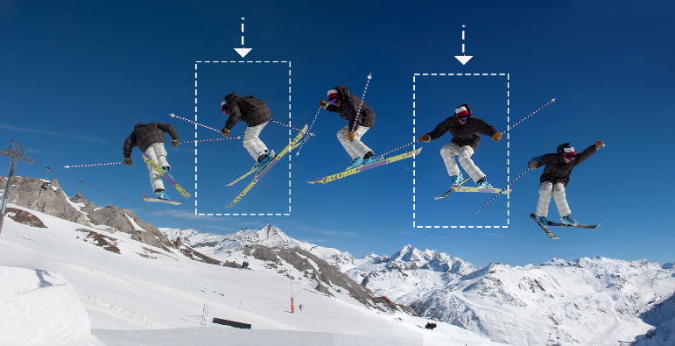
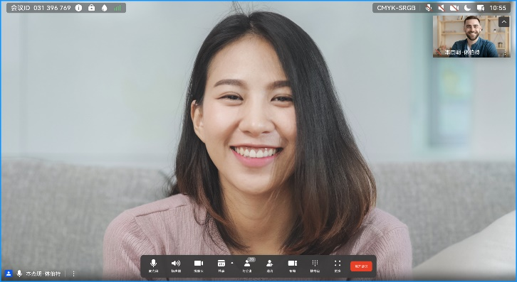
Professional Intelligent Meetings¹
4K video meetings
Built on a next-generation high-computing hardware platform architecture, the display adopts brand-new H.265 codec and proprietary VME technology, supporting 4K meetings at ultra-low bandwidth. The device also has powerful network adaptability with 30% packet loss concealment for videos.
Doubled frame rate
The frame rate doubling technology converts 30 fps video streams to 60 fps, delivering silky-smooth 4K videos with no smearing.
Secure and reliable meetings
Industry-leading full-link protection brings end-to-end high-security during meetings.
Audio watermarking
Audio leakage traceable via air channels.
One certificate per device
Each display has a unique certificate, preventing hijacking and spoofing.
Easy wireless projection and control
Wirelessly project mobile phone or PC content³ onto the display and enjoy 4K resolution instantly. The Touch tablet can be configured for efficient control operations, including sleep, wake-up, and adjusting brightness and volume of the display.
Notes:
完整16bit灰度等级
灰度等级是指LED显示屏单基色亮度中从最暗到最亮之间能区别的亮度级数。灰度是显示色彩数的决定因素。一般而言灰度等级越高，显示的色彩越丰富，明暗之间的过渡越自然，画面也越细腻，更易表现丰富的细节。目前市场上的高端LED显示屏产品均标称为16bit灰度等级（意即每个LED灯可表达2的16次方即65536种颜色）。但实际中，绝大多数厂商是实现不了上述灰度等级的，其原因在于，当刷新频率达到400Hz以上时，驱动电路带宽和数据传输带宽均趋近于理论极限，必须牺牲掉部分灰度等级来获得较高的刷新频率，这就使得显示屏黑色部分灰度不足，无法表现细节。
【清晰】4K显示
【清晰】刷新率，64Gray以上：64 Gray表示屏幕很暗的时候感受不到刷新，其他友商的刷新率是在亮度高的情况下
【层次】20000:1对比度
【层次】墨色一致性：△E*ab ＜ 0.5 更黑
【层次】灰度等级≥16bit：16bit灰度等级，明暗过渡自然，，画质更细腻，细节还原更精准
【色彩】色域：10.7亿绚丽色彩，≥85% BT.2020色域，画面色彩更加接近人眼真实世界观感
【护眼】AG防炫处理：采用AG防眩技术，减轻灯光与阳光照射屏幕对画面的干扰，无惧反光，让图像更清晰，人眼观看更舒适
【护眼】低蓝光认证：获得德国莱茵低蓝光认证，有效降低部分有害蓝光，呵护双眼
【护眼】亮度校正和颜色校正（待定）：出厂前亮度、色彩逐台校准

Slide 5
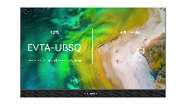
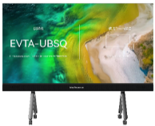
Technical Specifications
Specifications
Model
IdeaPresence 138
IdeaPresence 138 Pro
Display size
138" (16:9)
138" (16:9)
Display resolution
3840 × 2160P ⁴
3840×2160P
Physical resolution
1920 ×1080p
3840×2160P
Pixel density
16 ppi
32 ppi
Max. power consumption
1787 W
1808 W
Minimum viewing distance
2 m
1 m
Component
Device
Cable
Wall-mount bracket/Rolling stand
UHD codec
1
1 power cable and 1 HDMI cable
Included/Optional
Optional
Camera
Microphone
Touch
IdeaShare Key
Optional
Optional
Optional
Optional
Screen
Packaging process
Pixel pitch
Brightness
Color temperature
Flip-chip COB
P0.7
300–1000 nits (adjustable)
5000–9500K (adjustable)
Horizontal/Vertical viewing angle
Gray level
Protection level (front)
Refresh rate
170°/170°
16 bits
IP65
3840 Hz (64gray)
Black uniformity
AG anti-glare
Color gamut
LED lifetime
△E*ab < 0.5
Supported
≥ 85% BT.2020 & ≥ 99% sRGB
24/7 operation, lifespan > 100,000 hours
Speaker
Quantity
Rated power (per group)
Maximum volume
Frequency response
2 x 3 (stereo supported)
2 x 20 W + 20 W
95 dB
60 Hz to 20 kHz
Physical specifications
Dimensions (H x W x D; rolling stand)
Dimensions (H x W x D; wall-mounted bracket)
Net weight (with rolling stand/wall-mounted bracket)
Gross weight (display)
2564 mm x 3054 mm x 1034 mm
1888 mm x 3054 mm x 147 mm
247.5 kg/221 kg
440 kg
Power supply
Operating/Storage temperature
Operating/Storage humidity
100 V AC to 240 V AC, 50/60 Hz
–10℃ to +50℃/–20℃ to +60℃
10% to 80%RH/10% to 80%RH
Port
Audio/Video input port (front)
Power supply port
1 x HDMI
1 x power supply port
Meeting capability
Dual-stream resolution
Doubled frame rate
Call bandwidth
4K 30 fps + 4K 30 fps
Supported (4K 60 fps)
64 kbit/s to 8 Mbit/s
Feature
· Multistream meeting
· SiteCall
· Meeting control via web or Touch
· Dual-band Wi-Fi (2.4 GHz and 5 GHz)
· HD image snapshot (16:9 and 4:3)
· PiP (small window: 1/16 of the main window in size and adjustable position)
· LDAP address book
· Open APIs for third-party integration and development
Security
H.235/TLS encryption for signaling and SRTP encryption for media
Meeting access password, meeting control password, and administrator password
Dual-stream encryption
Note: 1: To access the meeting, doubled frame rate, security, intelligent features, and wireless projection functions, you must use the HUAWEI CloudLink Box 310/610 in conjunction with the display.
2: The screen temperature rise of 17°C refers to the average temperature rise of the screen relative to the ambient temperature when the product is working. The maximum temperature rise of the whole display is ≤ 20°C. The actual temperature rise may vary slightly depending on usage conditions and environments.
3: To use the wireless projection function, you need to download the IdeaShare app or configure an IdeaShare Key.
4: Optimize pixel arrangement using a pixel engine display technology, while achieving 4K display effects through digital algorithms.

Slide 6
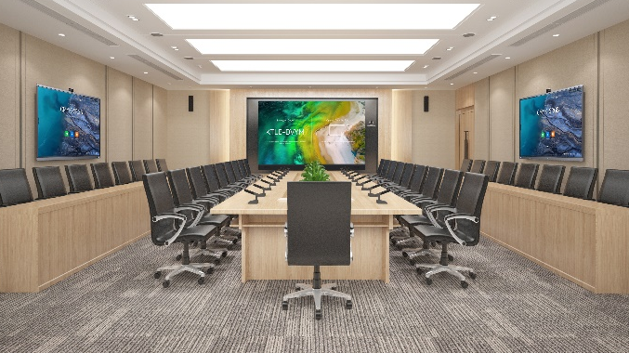
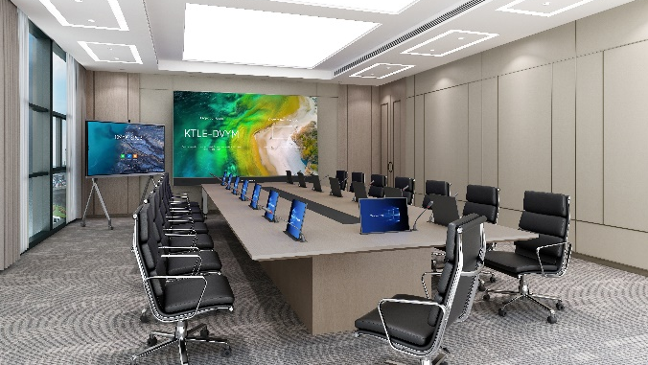
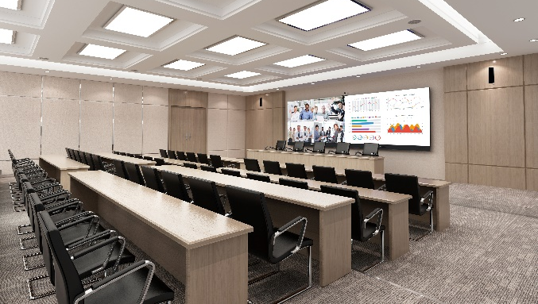
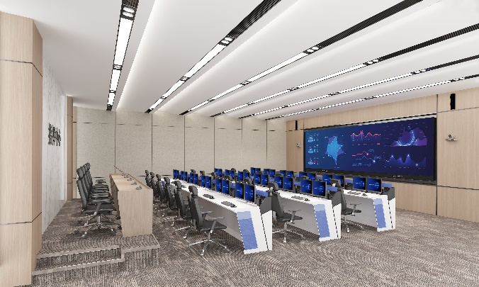
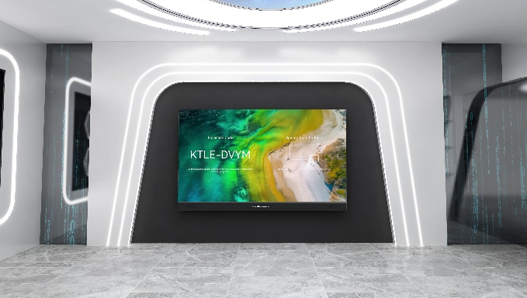
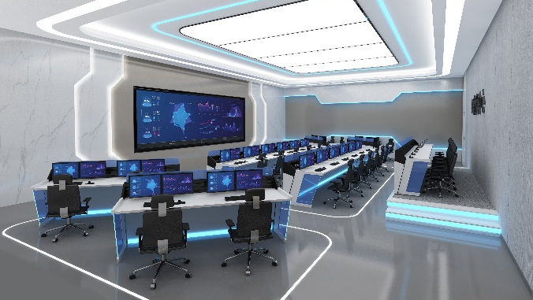
Application Scenarios
Midsized and large meeting rooms
Remote meeting, business reporting, and office work
High-level consultation room
Business consultation, VIP reception, and workshop
Lecture hall
Special speech, team building, and enterprise activity
Command center
Remote command, emergency attendance, and information display
Exhibition hall
Large-screen display, animation demo, and interactive experience
IOC
Real-time detection, comprehensive situation analysis, and video meeting
Disclaimer
Data and figures in this document are for reference only. The information contained in this document, including but not limited to the product appearance, specifications, and function description, may vary depending on the actual product release. This document does not constitute a warranty of any kind, expressed or implied. Product specifications are subject to change without notice in advance. The company may update the document from time to time and reserves the right to update and correct the information about related products or solutions. For details, see the latest description or introduction.
Revision date: July 2025

