Slide 1

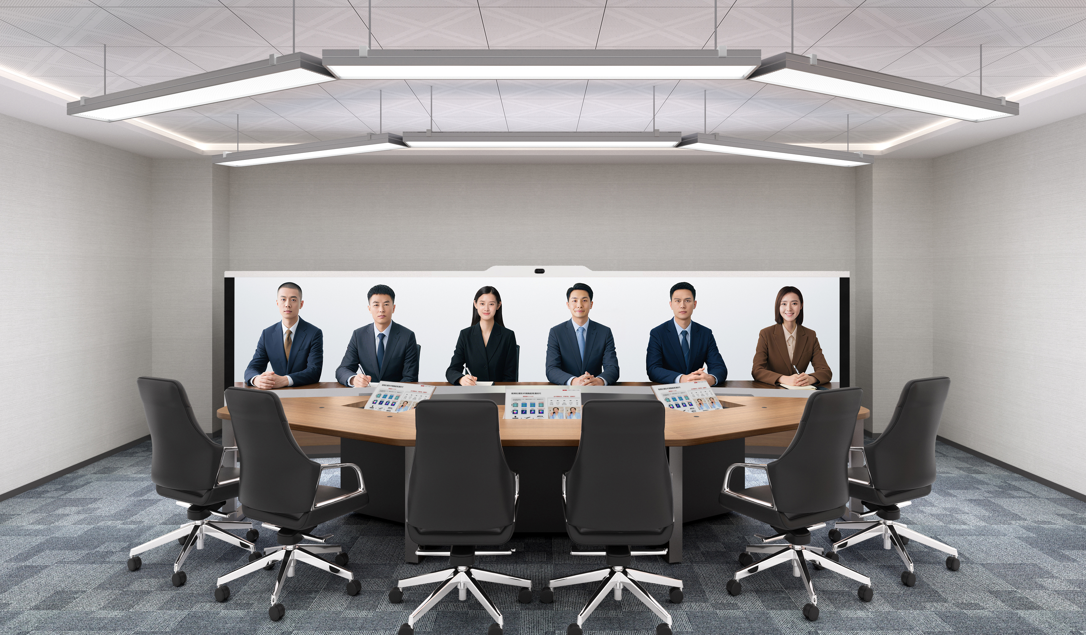
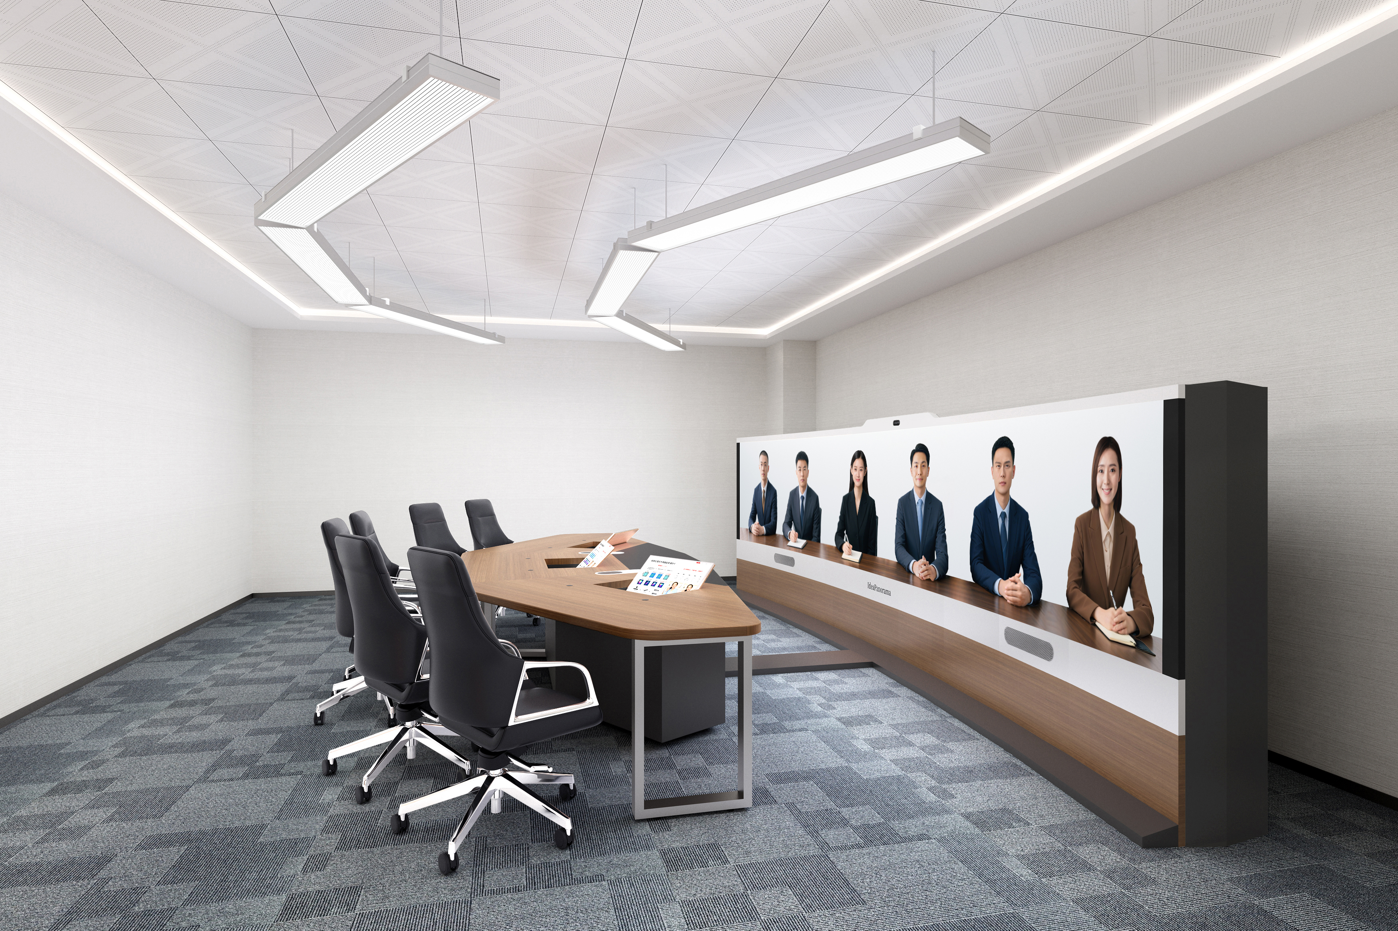
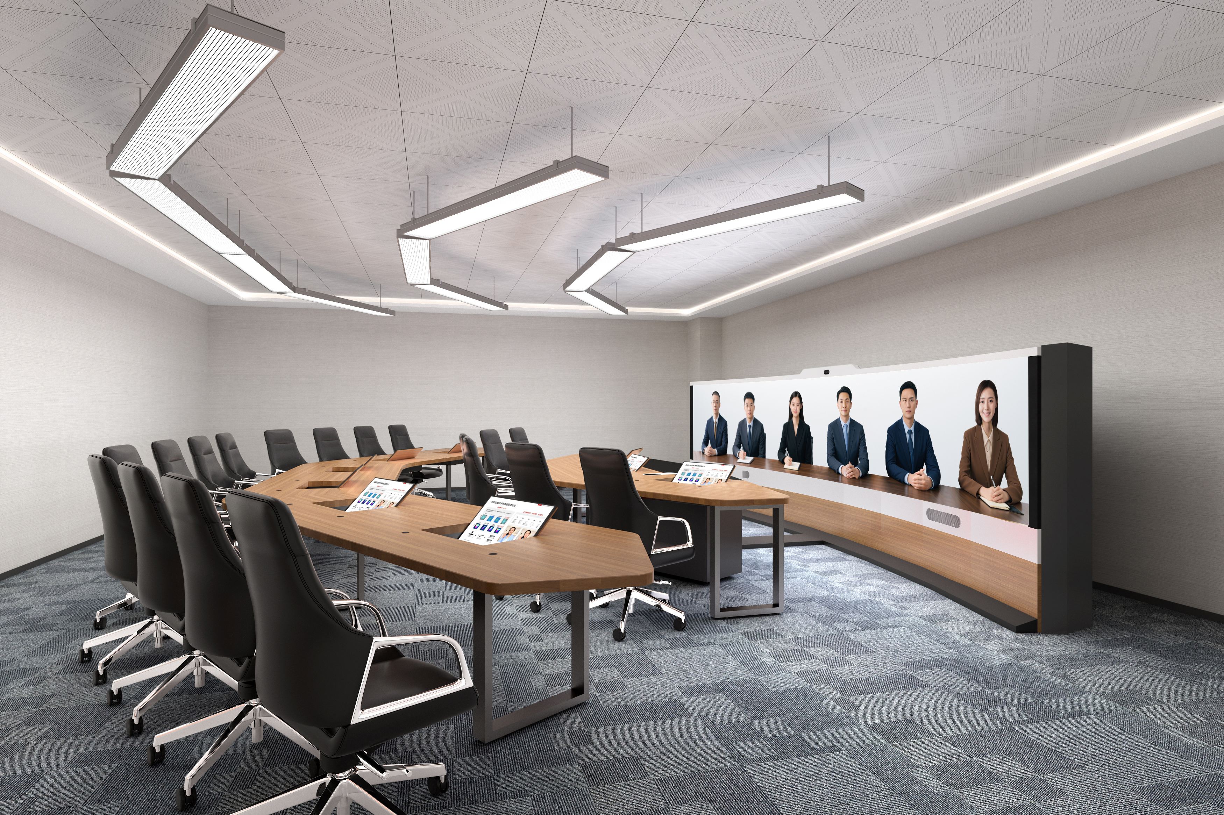

Immersive Telepresence System
Overview
The brand-new immersive telepresence system uses Huawei’s TP6206 immersive telepresence suite (panoramic fusion camera, brand-new codec and seamless LED curved screen) to deliver 1:1 ultra-realistic images, perfectly reproducing the facial expressions and details of remote participants. The system also provides multi-channel surround audio to create a high-end immersive experience, which can be widely used in scenarios such as high-level conferences, telemedicine, and emergency command.
Immersive Telepresence TPX6206 (single-row)
Single-row telepresence for 6 participants
Conference room area ≥ 38 m²
Dimensions (H x W x D): 2700 mm x 7480 mm x 5085 mm
Immersive Telepresence TPX6218 (dual-row)
Dual-row telepresence for 18 participants
Conference room area ≥ 74 m²
Dimensions (H x W x D): 2700 mm x 10500 mm x 7085 mm
Product highlights
High-level design aesthetics, delivering an immersive business experience
Breaking the boundaries of traditional tri-screen design, providing a truly immersive experience
The brand-new appearance design seamlessly integrates the camera, microphone, speaker, and screen, offering a visually expansive experience. The integrated system is simple yet professional.
Supports front and rear installation and maintenance and quick deployment, saves conference room space, and supports local conferences, meeting customer requirements in various application scenarios.
Delivers professional lighting, color, and sound field optimization and applies ergonomics to system design to deliver an optimal meeting experience.
Huawei's latest AI panoramic fusion camera uses the multi-modal AI optical flow algorithm to seamlessly fuse UHD 4K images from three lenses at different depths.
216-inch curved screen with micron-level stitching, delivering a seamless and smooth visual experience; 48:9 ultra-HD wide screen, covering the entire field of view; ultimate image quality, delivering a more authentic and colorful world.
Life-size 1:1 display, making the posture and eye contact of remote participants appear as natural as face-to-face communication.
Sound localization, delivering an immersive audiovisual experience
AI-powered meetings, delivering an innovative experience while boosting conference efficiency
Brand-new microphone and multi-channel sound reinforcement system.
Each seat in a single-row or dual-row setup is equipped with an independent next-generation desktop microphone for sound pickup from a long distance.
The next-generation microphone has an independent status indicator, clearly showing the current status.
High-fidelity speakers support sound source localization and playback, using the latest algorithm technology to achieve precise sound localization.
Intelligent meeting space management, implementing intelligent control of devices and the environment in the conference room.
The panoramic camera intelligently identifies human faces and automatically switches between standing and sitting modes.
01

Slide 2

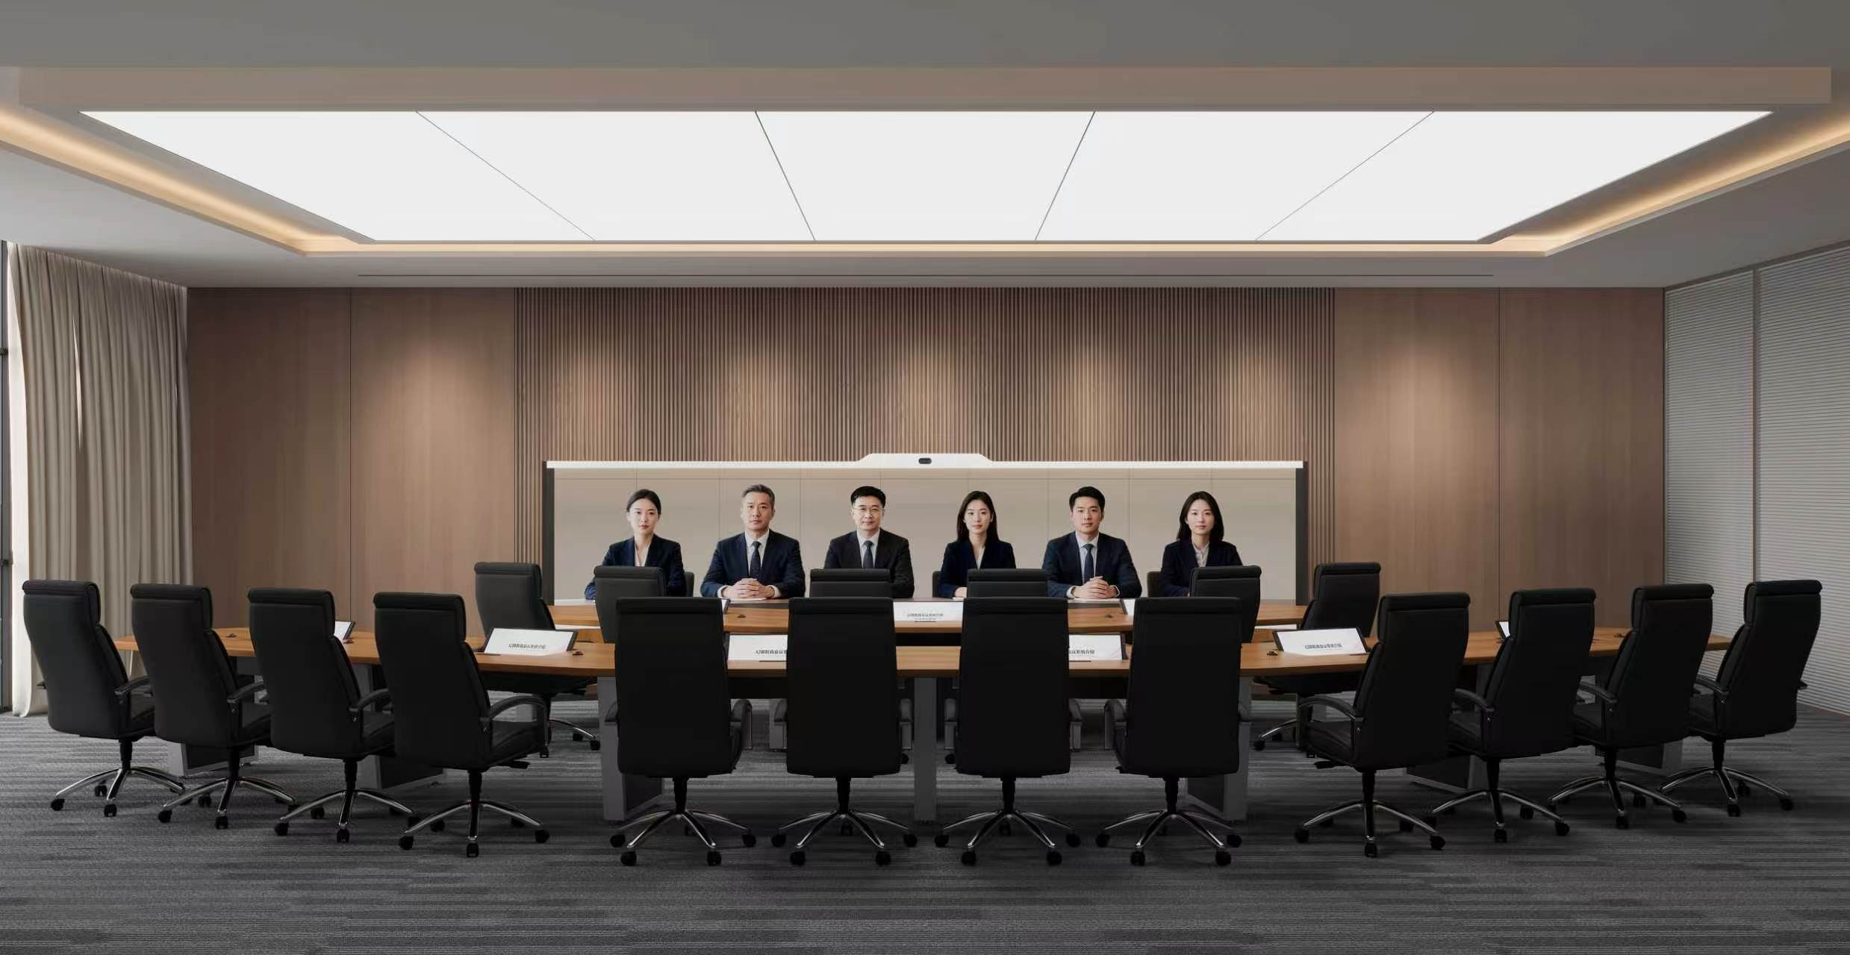
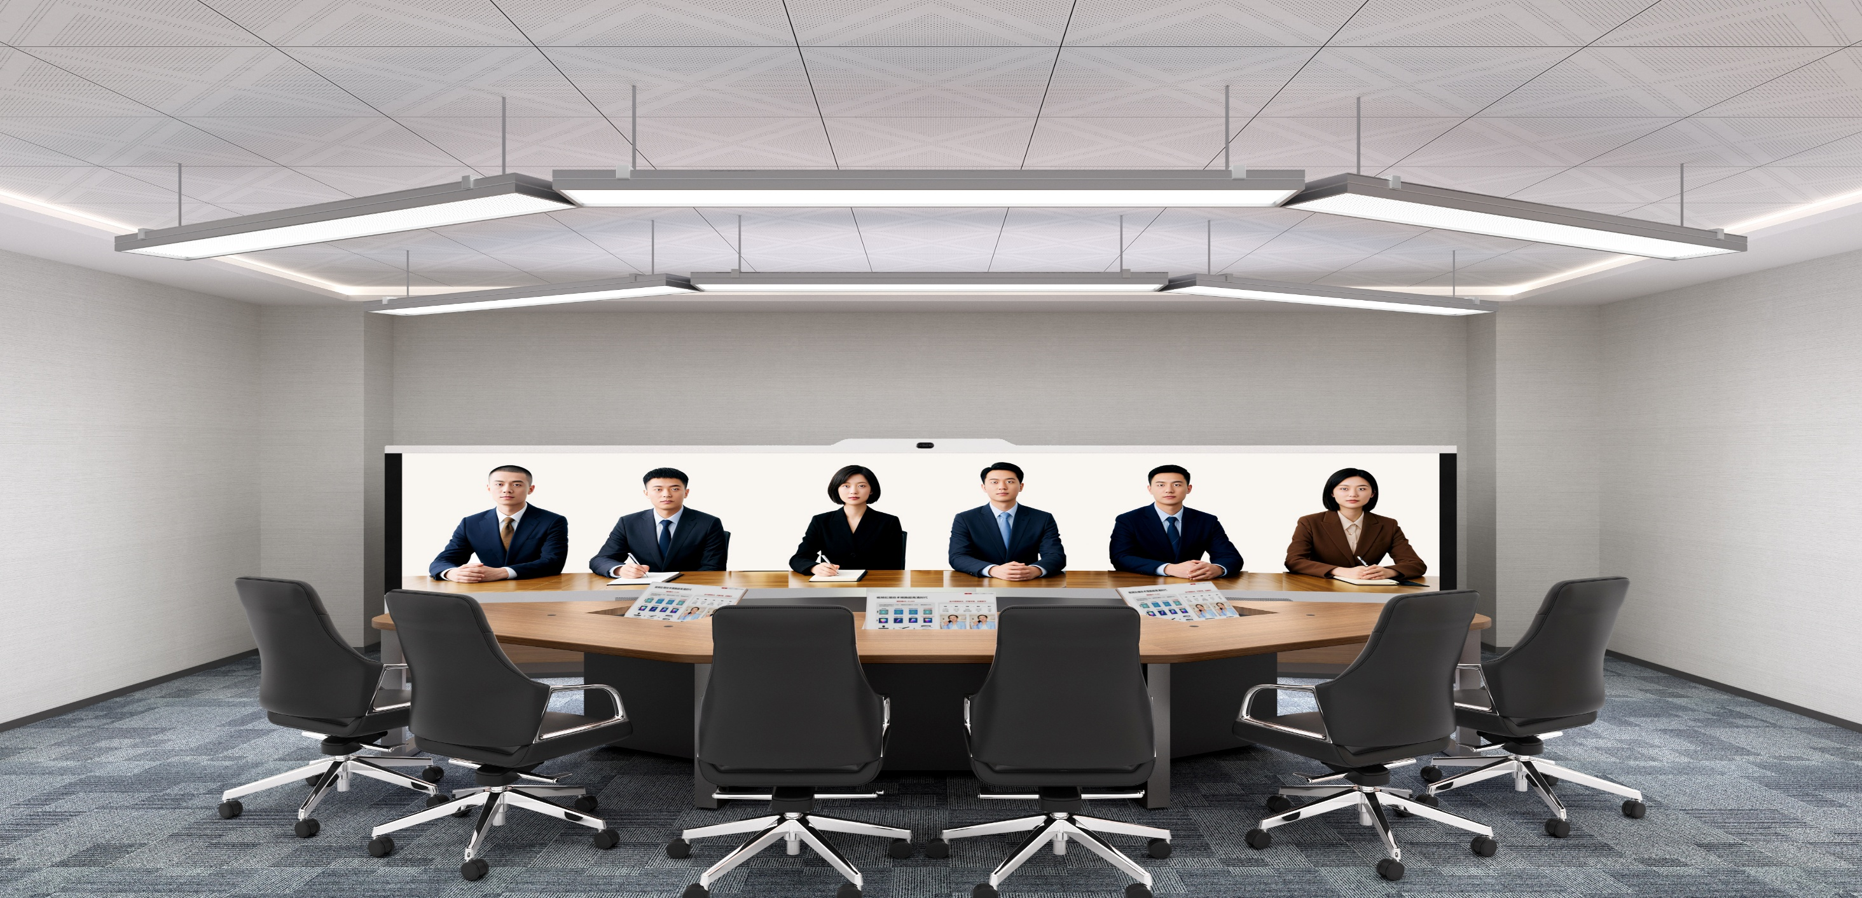

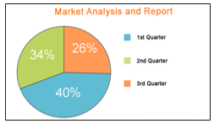

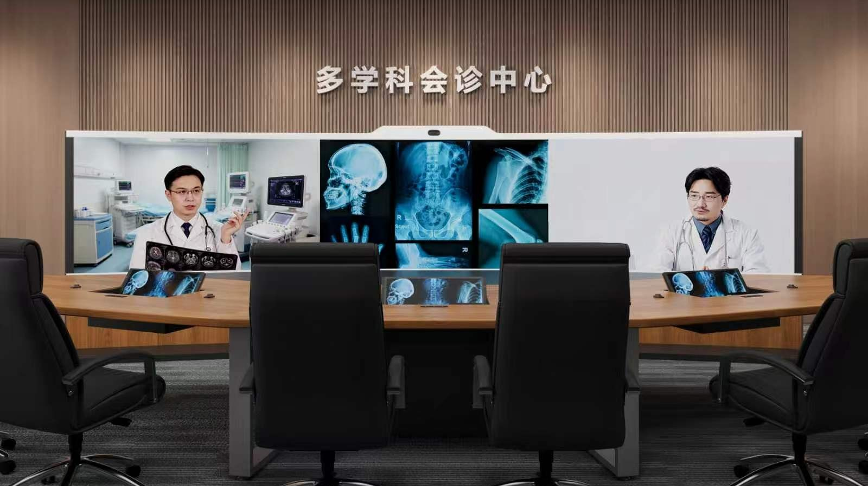
Simplified, intelligent control and interaction, enabling efficient conference experiences
Worry-free meetings, ensuring security
The Touch uses the widget-based HarmonyOS UI design, which is easy to use and supports customization of personalized elements, highlighting the enterprise image.
User-friendly design: one-tap power-on/off, one-tap diagnostics, one-tap mute, one-tap call, and quick presentation sending.
A wide array of conference control functions, such as initiating a call directly from an endpoint (also known as SiteCall), selecting specific participants to view, setting continuous presence as the chair, and focusing on the speaker.
Invisible audio and video watermarks, enabling traceability of unauthorized recordings and content leaks.
Visible presentation watermarking, warning and deterring data leaks.
Application scenarios
Administrative meetings and executive decision-making meetings
Applicable to decision-making meetings and executive consultations.
Characteristics: face-to-face meeting experience, 1:1 life-size display, sound localization.
Multi-party remote video conference
Applicable to daily administrative conferences and publicity conferences.
Characteristics: multiple types of video conferencing endpoints, flexible conference control.
Remote consultation
Applicable to remote consultation, remote surgery guidance, remote teaching, and remote medical training.
Characteristics: multi-signal integration and multi-pane display.
02

Slide 3
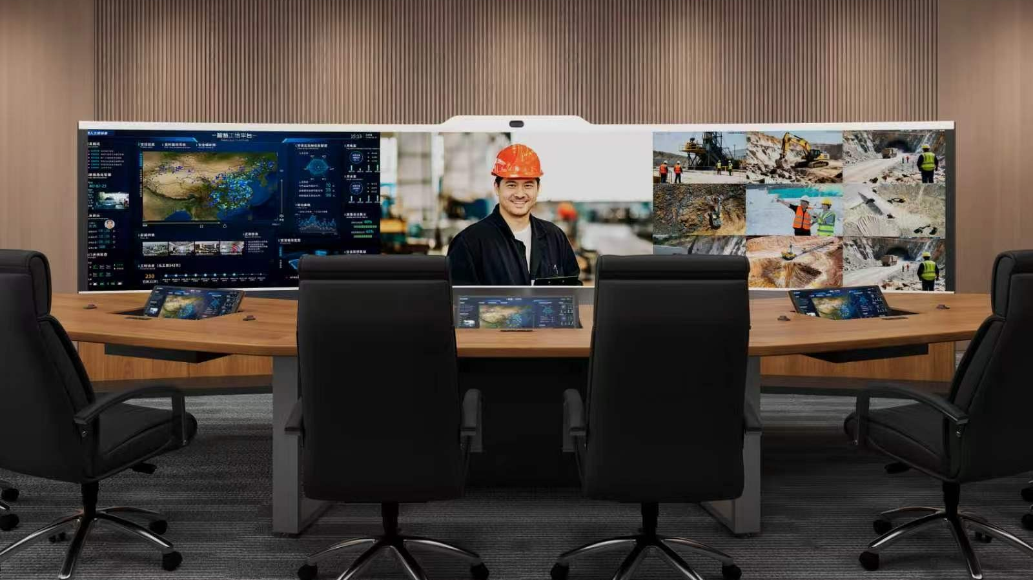

Command and dispatch
Applicable to disaster response and command dispatch.
Characteristics: system signal convergence, quick invoking of security monitoring data, and multi-pane display.
Product features
Main system components
Telepresence codec, seamless panoramic fusion camera, 216-inch curved LED display, signal scheduling system, high-fidelity speaker, hidden microphone, dedicated tabletop display, and professional conference table.
Communications and interfaces
Communication framework
ITU-T H.323, IETF SIP
Video protocol
H.265, H.264HP, H.264BP, H.263, H.263+
Audio protocol
AAC-LD (mono and stereo), G.711A, G.711U, G.722, G.722.1C, G.729A, OPUS, and G.719
Video format
4K 25/30/50/60fps, 1080p 25/30/50/60fps, 720p 25/30/50/60fps, 4CIF/4SIF, SIF/CIF/QSIF/QCIF/SQSIF/SQCIF
Dual-stream protocol
ITU-T H.239, IETF BFCP, data
Other communications protocols
H.225, H.233, H.235, H.241, H.245, H.281, H.283, H.350, H.460, and T.140
Network transmission protocol
TCP/IP, RTP, RTCP, DHCP, DNS, SNTP, SSH, HTTPS, TR-069, IEEE 802.1p/q, IEEE 802.1X
Line and bandwidth
H. 265
H. 264HP
720p 30 fps:
The minimum bandwidth is 3 x 512 kbit/s, and the recommended bandwidth is 3 x 768 kbit/s.
720p 30fps:
The minimum bandwidth is 3 x 768 kbit/s, and the recommended bandwidth is 3 x 1 Mbit/s.
1080p 30 fps:
The minimum bandwidth is 3 x 768 kbit/s, and the recommended bandwidth is 3 x 1 Mbit/s.
1080p 30fps:
The minimum bandwidth is 3 x 1 Mbit/s, and the recommended bandwidth is 3 x 1.5 Mbit/s.
Bandwidth range
1080p 60 fps:
The minimum bandwidth is 3 x 1 Mbit/s, and the recommended bandwidth is 3 x 2 Mbit/s.
1080p 60fps:
The minimum bandwidth is 3 x 2 Mbit/s, and the recommended bandwidth is 3 x 3 Mbit/s.
4K 30 fps:
The minimum bandwidth is 3 x 2 Mbit/s, and the recommended bandwidth is 3 x 3 Mbit/s.
4K 60 fps:
The minimum bandwidth is 3 x 4 Mbit/s, and the recommended bandwidth is 3 x 6 Mbit/s.
02

Slide 4
Screen parameters
Screen size: 5400 mm x 1012.5 mm
Total screen area: 5.47 m²
Screen resolution: 5760 x 1080
Encapsulation technology: full flip-chip COB
Main screen
Electric tabletop display
Screen size: 21.5 inches
Screen resolution: 1920 x 1080
Dedicated touchscreen
Screen size: 11 inches
Screen resolution: 1920 x 1200
Camera parameters
Lens
12 MP, 1/2.3-inch
Video output
Three HDMI 2.0 HD display outputs, each supporting 4K 60 fps
Horizontal field of view
100°
Image adjustment
Adjustment of image brightness, sharpness, saturation, contrast, and hue
Maximum power consumption
25 W
Environment requirements
Temperature
0°C to 40°C (ambient temperature)
Relative humidity
10% to 95%
Ambient noise
< 43 dBA SPL
Recommended illuminance
Vertical illuminance: 850±100 lux Horizontal illuminance: 950±100 lux
Conference room space
(H x W x D)
TPX6206 (single-row): 2700 mm x 7480 mm x 5085 mm
TPX6218 (dual-row): 2700 mm x 10500 mm x 7085 mm
Power supply and power
Input voltage range
100V-240VAC, 50 Hz-60 Hz
Power
TPX6206 (single-row): < 3072.5 W (peak power)
TPX6218 (dual-row): < 3492.5 W (peak power)
Dimensions and weight
Device dimensions
Media wall dimensions: 5576 mm x 385 mm x 1776 mm
First-row conference table dimensions: 5480 mm x 1830 mm x 750 mm
Second-row conference table dimensions: 8500 mm x 1992 mm x 750 mm
Weight
TPX6206 (single-row): 770 kg
TPX6218 (dual-row): 1100 kg
03

